Slide 1
Creating a rainstorm using infrared and C#
Lisa Taylor
Notes:
Hi everyone,
Congratulations on making it to the last talk of the day.
We’re going to have a bit of fun here.
Today I’m going to be talking about how I created an interactive rainstorm using infrared and C#

Slide 2
GIANT Disclaimer
I am here as ME. This was a side project with friends FOR FUN.
It was a non-profit, spare time, “can we even make this work?!” challenge.
I do not work for Microsoft.
This project was ART FOR ART’S SAKE.
Cool? Alright, let’s get going!
Notes:
First thing’s first.
I am here as ME. This was a side project with friends FOR FUN.
It was a non-profit, spare time, “can we even make this thing work?!” challenge This is a very kinect focused talk, but I do not work for microsoft. I’m not trying to sell you on the kinect. and
This project was ART FOR ART’S SAKE.
So if I say something stupid, that’s just me. We cool? Alright, let’s get going!

Slide 3
Hi, I’m Lisa
@Lisa3x3x3
photo credit: Lloyd Derby
Notes:
Hi, I’m Lisa Taylor.
I’m from the coolest little capital city in the world called...
photo credit: Lloyd Derby

Slide 4

Notes:
Wellington!
Which is in New Zealand!
Not Australia for those who are not sure about the geography of that side of the world
or couldn't figure out where my accent is from.
It’s always super windy and we seem to be super proud of this.
Hence the sign is appearing to be blown away
img: http://www.go4travelblog.com/wp-content/uploads/2014/07/Wellington-Sign.png

Slide 5

Notes:
We’re a little bit quirky.

Slide 6

Notes:
We call ourselves “kiwi’s” after our national native bird.
And our parliament building is called the Beehive, because, well, it’s shaped like a bee hive.

Slide 7

Notes:
And it’s full of Hobbits.
But ANYWAY
img1: https://www.expedia.co.nz/Beehive-Wellington.d6108406.Attraction
img2: http://www.kiwibird.org/wordpress/wp-content/uploads/baby-kiwi.jpg
img3: http://www.theonering.com/galleries/the-lord-of-the-rings-movies/cast/the-hobbits-lila-sandybanks

Slide 8
What do you do?
Notes:
What do I do?
I find when people ask this question, they’re not asking;
what do you do for fun
or
what are your interesting hobbies
or
how do you challenge yourself?

Slide 9
What do you do?
For a job
Notes:
They’re asking
“what do you do for a job”
or
“what are you qualified to do”.
And I love my job! I love doing what I do and getting paid to do it (obviously, gots to gets paid!).
But I do so much more.

Slide 10

Notes:
My day-to-day job is software development.
I work at a company called PartsTrader,
writing code for the online parts procurement solution for collision repairers in the United states.

Slide 11

Notes:
But by night, I use my programming superpowers to create art!
So, what do I do?
img: https://www.vectorstock.com/royalty-free-vector/superhero-couple-vector-745873

Slide 12
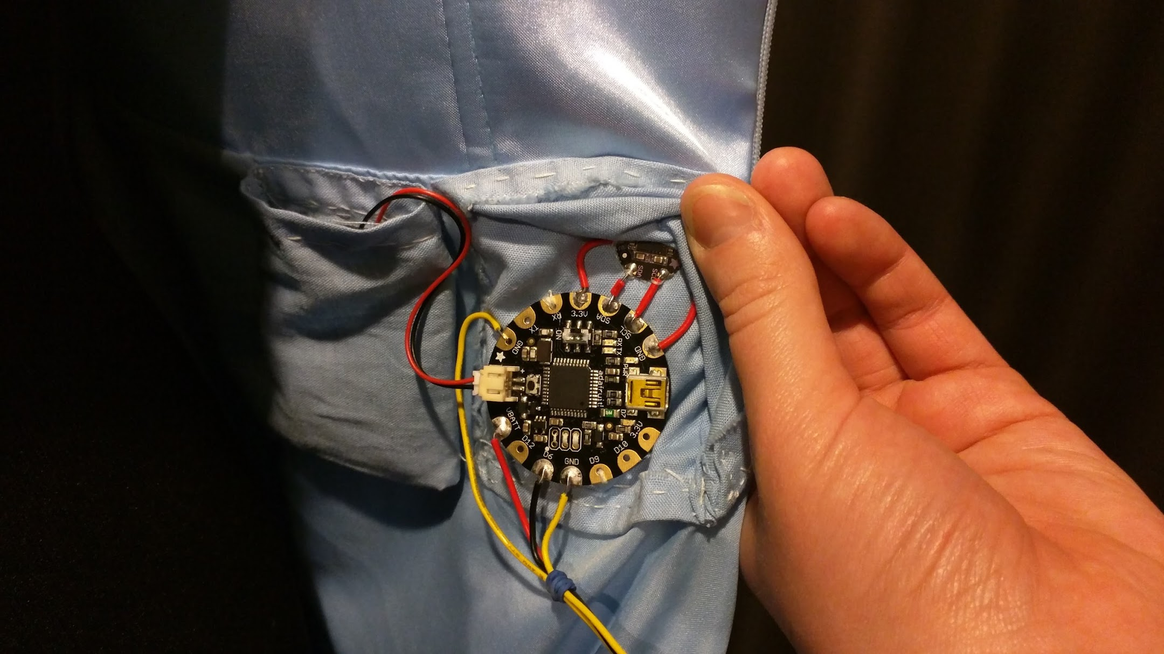
I do
Stuff
Notes:
I do stuff
I make things!
This is a FLORA microcontroller and accelerometer that’s wired into my sister’s prom dress,
so that when she danced,
the Accelerometer would detect the motion
and trigger LEDs sewin all around her dress,
to flash randomly and appear to twinkle.

Slide 13
“Software Developer” doesn’t accurately define
what I do
Notes:
So saying I’m a software developer,
doesn’t accurately define what I do.
But rather

Slide 14

SKILLS AND KNOWLEDGE
to be
CREATIVE
Notes:
being a developer gives me the skills and knowledge
to enjoy what I love most of all.
And that’s being creative

Slide 15

Notes:
And being creative means I get to solve all the problems in perhaps weird or interesting ways,
But by doing so, I discover new things!

Slide 16

Notes:
Things like making an interactive rainstorm… *lul wut*
This need for wanting to be creative and to solve all the problems, one day got the better of me.
I was catching up with my friend, Josh Bailey.
He mentioned an art project that he and Debbie Fish were trying to create called “Rainscape”.
Josh said that they had tried many different motion detection programs,
but none of them were capable of what they were wanting to achieve.
An interactive rainstorm.
Something that allowed the user to influence the rain,

Slide 17

Notes:
Thunder

Slide 18

Notes:
and lightning around them.

Slide 19
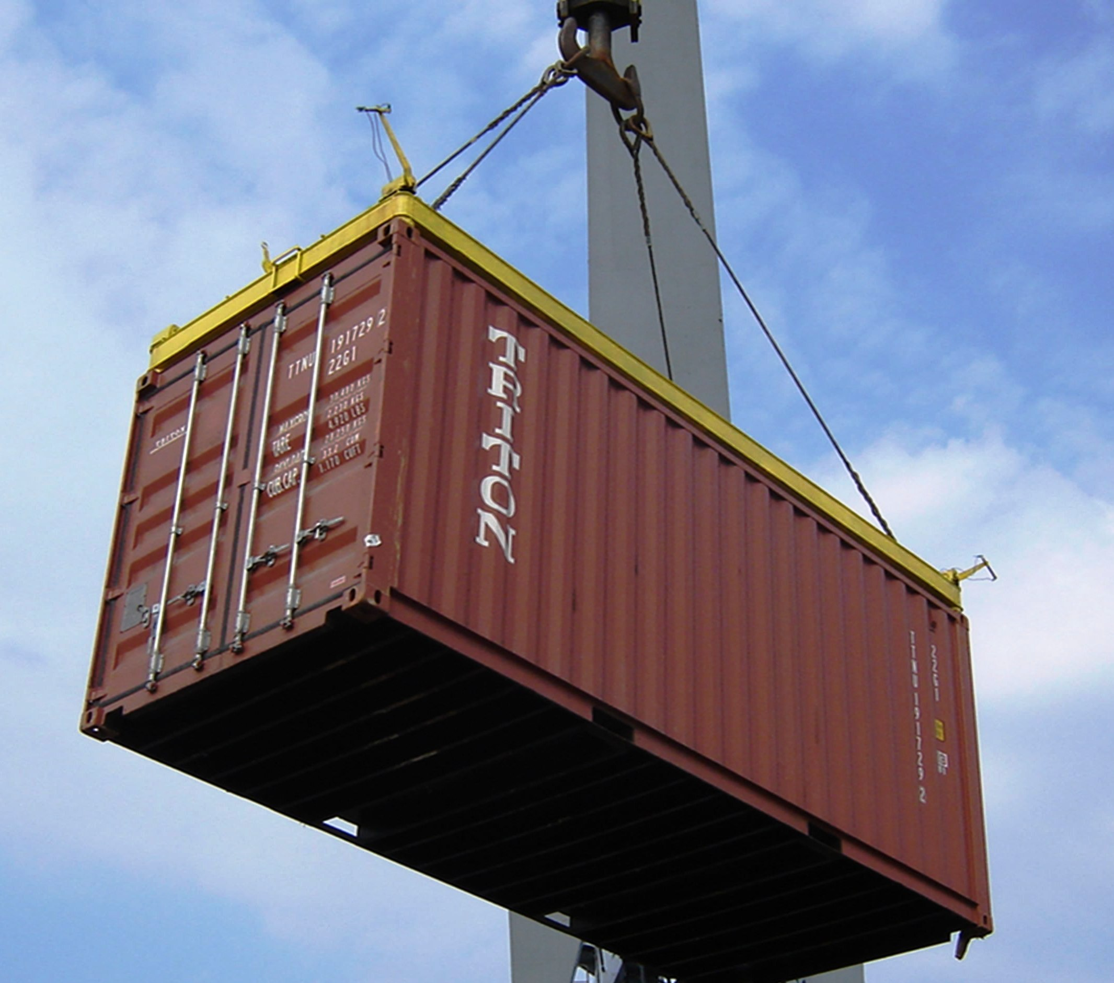
Notes:
As they walk through a shipping container.
img: http://www.fanpop.com/clubs/piyal-%25E2%259D%25A5/images/34558502/title/raining-photo
img: http://www.wired.com/wp-content/uploads/blogs/insights/wp-content/uploads/2012/11/clouds_660.jpg
img: http://ecmweb.com/site-files/ecmweb.com/files/archive/ecmweb.com/mag/706ecmLightningPic1.jpg

Slide 20
Notes:
/* imagine…
an art installation
inside a dark shipping container
you walk through a storm
altering the surroundings,
but never being able to control it..
*/
Essentially, this was a motion detection problem.

Slide 21
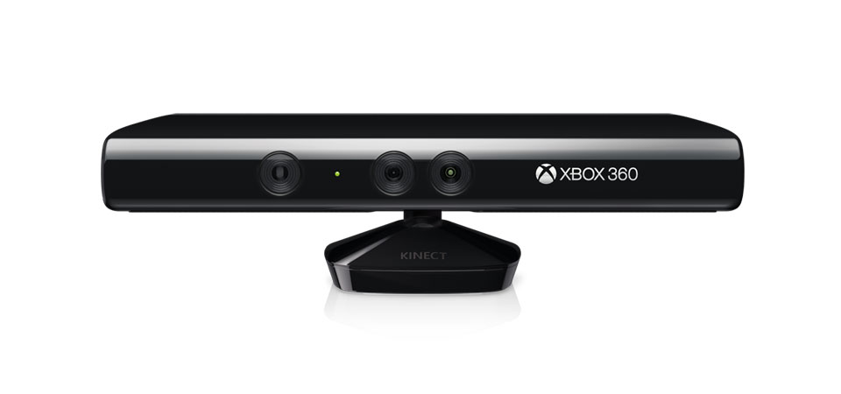
Notes:
I quickly said “You could use the kinect and write the software yourself to do that!”
Now, Josh is a very smart guy.
He writes a bunch of code for Software Defined Networking and makes music through Tesla coils!
But he’s wasn’t raised on the Microsoft stack like I was.
So Josh said to me...

Slide 22
“You sound like you know
what you’re doing.
Notes:
“You sound like you know what you’re doing.

Slide 23
“You sound like you know
what you’re doing.
You should do it.”
Notes:
You should do it”.
I walked right into that one.
But I love a challenge. So I agreed to help out and build an interactive rainstorm..
Although, I still wasn’t really too sure what that was.

Slide 24
How does it work?
Notes:
Right, I've declared how easy it would be to use this thing.
I better figure out how it works.
I had read about people using the kinect to create their own games or use gestures to control presentations.
I’ve made fairly simple 2D collision detection games in the past, but I had never done anything like this before.
When we started this project, I didn’t even own a kinect!
I had to learn, and I had to learn fast. Because if this method wasn’t going to work,
we would have to find another way and start from scratch all over again.

Slide 25
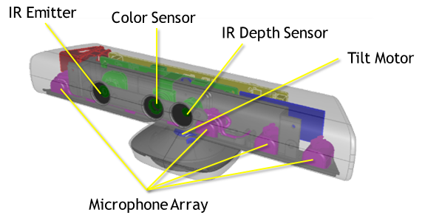
image source: msdn.microsoft.com
Notes:
Here’s an overview the kinect that I stole from the MSDN website

Slide 26
image source: msdn.microsoft.com
Notes:
There’s a Tilt motor, because manual adjustment is overrated and everyone should learn how to program tiny motors.

Slide 27
image source: msdn.microsoft.com
Notes:
A colour sensor that creates the kinects colour image at 1280x960 resolution.

Slide 28
image source: msdn.microsoft.com
Notes:
A microphone array for detecting the location of and capturing of sound.

Slide 29
image source: msdn.microsoft.com
Notes:
And then there’s the Infrared Emitter & Infrared Depth Sensor which is used to create the kinects depth image
But how does the emitter and depth sensor work?
img: https://msdn.microsoft.com/en-us/library/jj131033.aspx

Slide 30
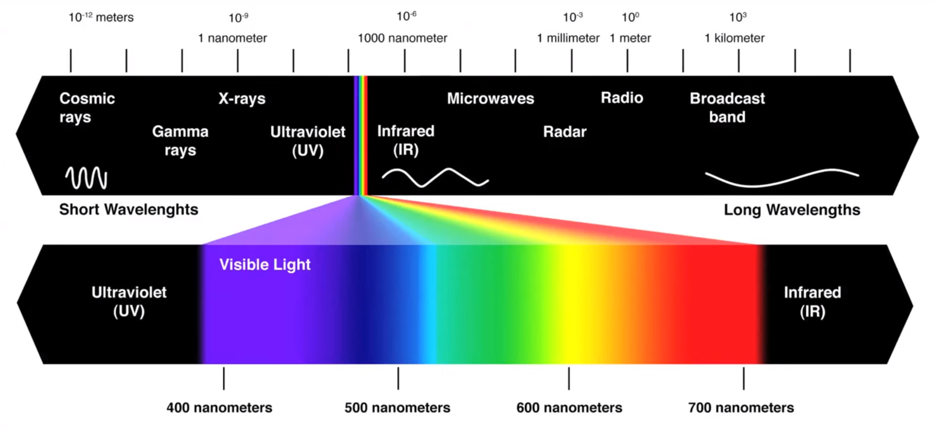
This goodness
image source: Vsauce - What does Earth look like? Youtube.com
Notes:
So we all know infrared is part of the colour spectrum that we generally can’t see.
Ignore the rest for now, all we care about is this infrared goodness.
Infrared is electromagnetic radiation with longer wavelengths than visible light,
although some people are able to see the shorter of these infrared waves.
Img: https://www.youtube.com/watch?v=2lR7s1Y6Zig
Vsauce - What does Earth look like?

Slide 31
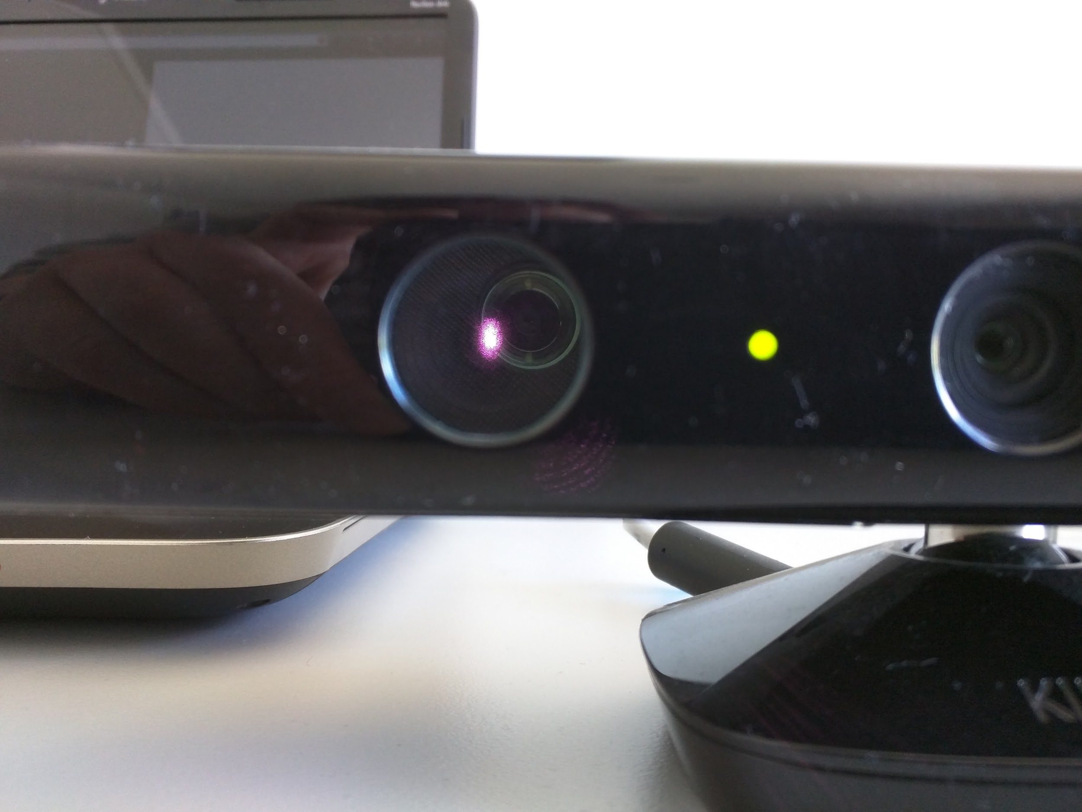
Infrared Emitter
Notes:
Looking at a kinect straight on, we might be able to detect a small amount of light from the emitter,
but only enough for our eyes to see that something is glowing.
Through a different lens, the infrared emitted actually looks like this.

Slide 32
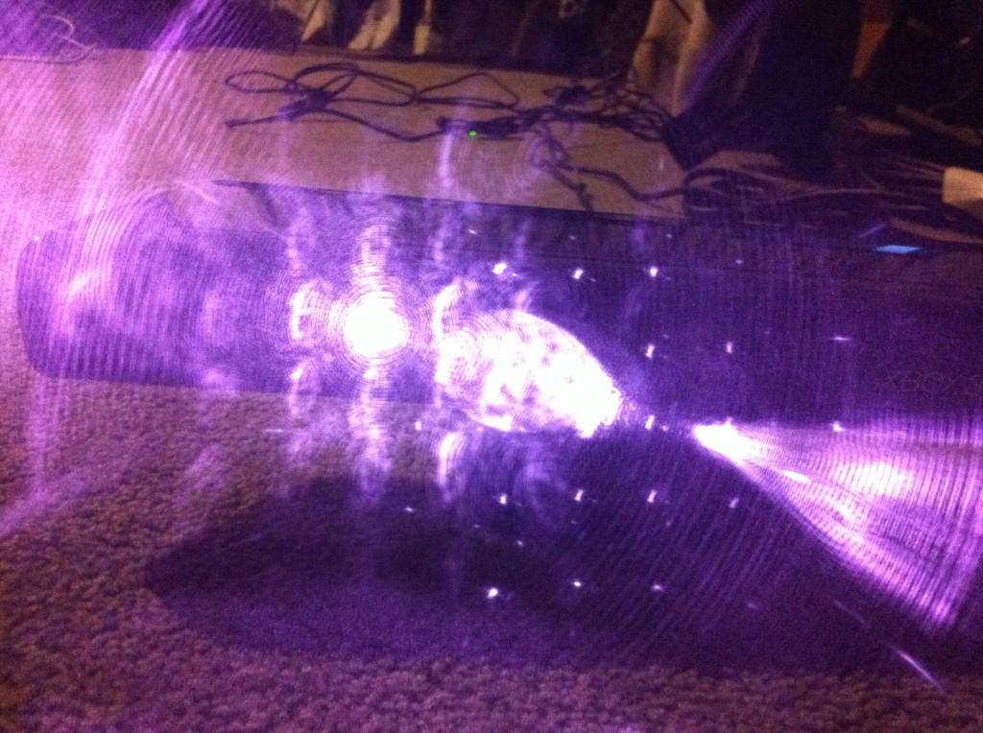
Notes:
Thousands of infrared beams of light are being emitted from the kinect.
I took this picture on my iphone 4.
Some more modern cameras have built in Infrared filters so they won’t be able to detect this light either.
But it’s there.
So how does this help build up our depth image?

Slide 33
living room
Kinect
Notes:
Here’s an example of how this would work in my living room

Slide 34
living room
Kinect
Notes:
The kinects infrared emitter, emits infrared light beams out into the space.

Slide 35
living room
Kinect
Notes:
When the beams hit an object, they’re reflected.
The depth sensor reads the infrared beams reflected back to the sensor.

Slide 36
living room
Kinect
2 meters
Notes:
The reflected beams are converted into depth information
measuring the distance between an object and the sensor.

Slide 37
living room
Kinect
Notes:
So if someone walked through that space,

Slide 38
living room
Kinect
Notes:
they would interrupt the beams

Slide 39
living room
Kinect
1m
Notes:
and the new object at a closer distance would be read.

Slide 40
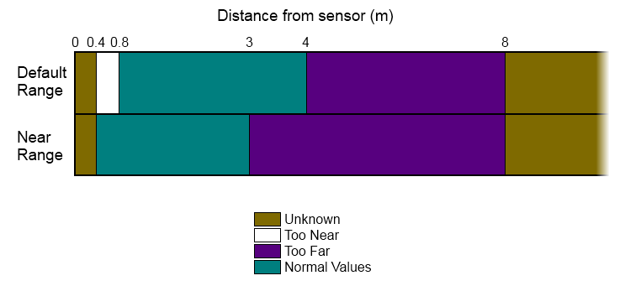
Distance from sensor (m)
image source: msdn.microsoft.com
Notes:
But the kinects are only for home use.
The emitter and depth sensor are not very powerful, so we’re limited to reading depth within a space of up to 4 meters away from the sensor.
And some objects that get too close, won’t be detected at all.
The depth range that we’re guaranteed, is indicated in the aqua colour on the bar.
Between 0.8 and 4 meters from the sensor.
Anything else, and the kinect won’t be able to measure it accurately.

Slide 41
Hardware components
Infrared
Distance restrictions
Notes:
We’ve gone over a lot so far, so let’s quickly recap,
We have looked at

Slide 42
Hardware components
Infrared
Distance restrictions
Notes:
the various hardware components,

Slide 43
Hardware components
Infrared
Distance restrictions
Notes:
Infrared light and how the reflection back is what determines our depth values,

Slide 44
Hardware components
Infrared
Distance restrictions
Notes:
and the distance restrictions, which aren’t actually that bad for a consumer gaming device
Oh, and by the way, I have a scrollable bookmark in my browser for all this stuff.
The problem I kept running into was that the information online was inconsistent.
So many pages stated incorrect things, very minor, but not ideal for someone getting started.
So this is my gift to you, a concise, super fast crash course in kinect 101.
You can keep that.
By this point, I hadn’t even fired up the code yet.
But I now had a much clearer understanding of what the kinect was and how we could use it.

Slide 45
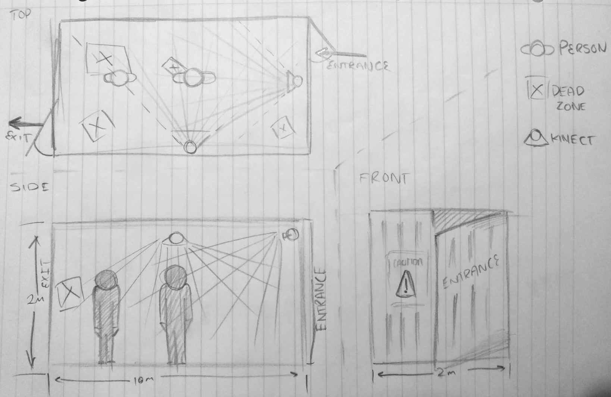
Notes:
At first we tossed up different ways of mapping the area.
We drew pencil sketches of shipping containers,
with Kinects monitoring from x y coordinates,
so that we could minimize people creating dark zones.
Then we thought about x, y and z positions for the kinect so that every angle could be monitored.
I suggested using the kinect initially because I knew the inside of the shipping container would be dark
but using the infrared meant that we ruled out the problem of being able to see in the dark.
As we were discussing this, I kept thinking “this is going to be very hard”

Slide 46
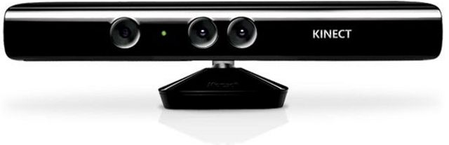
Acquire a kinect... (or two?!)
Notes:
Aside from it being hard, I still needed to source a kinect..
..or two..?
FUN FACT: The version 1 kinect came out in two delicious flavours,

Slide 47
Acquire a kinect... (or two?!)
Notes:
One for the Xbox - with minimal support for a beta SDK,
shown here at the top.

Slide 48
Acquire a kinect... (or two?!)
Notes:
and one for Windows with all the bells and whistles and for many more monies,
shown here at the bottom..
They look pretty similar to me..

Slide 49
Acquire a kinect... (or two?!)
Notes:
All of my research had been around the kinect for the Xbox
and since my art budget was a GRAND TOTAL of ZERO dollars..
image: http://www.hitc.com/en-gb/2014/12/31/microsoft-to-discontinue-original-kinect-for-windows-in-2015/

Slide 50
Notes:
I opted to go for the abundantly available kinect for xbox.

Slide 51
BETA SDK ALL THE WAY!
Notes:
BETA SDK ALL THE WAY!
I didn’t want to have to pay a stupid amount of money for something that could essentially do exactly the same thing.
This just meant it was just going to be a little bit more restricting and finickity for me to manipulate.
Buuuut, I’ll just keep reminding myself about how much I love a challenge and soldier on..

Slide 52
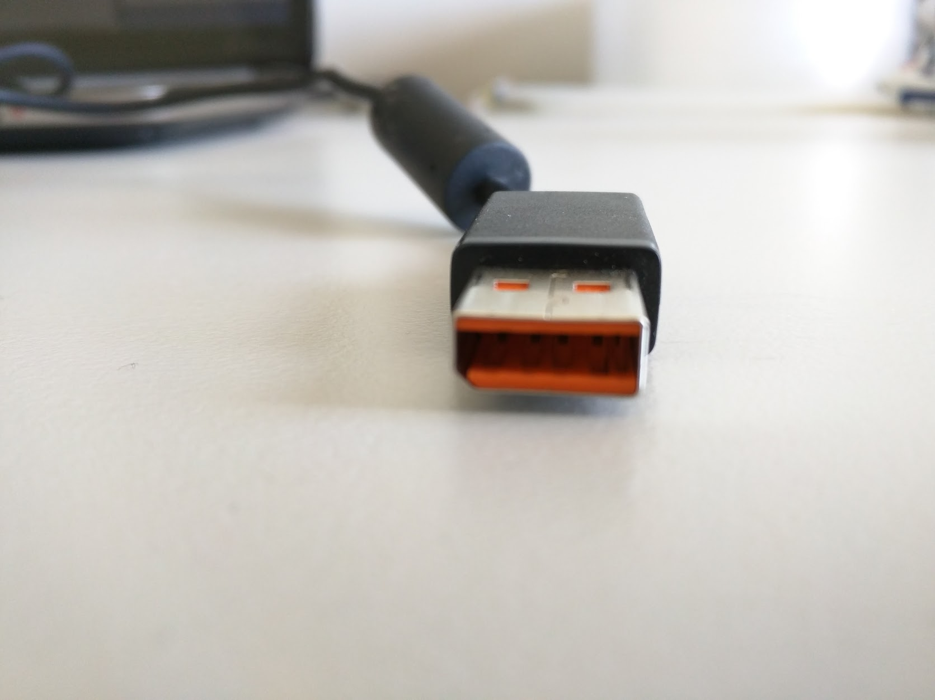
What is this?!
Notes:
Also, what is this?! Well, this is the plug for the kinect, but what I’m trying to point out here is the lopped off edge.
FUN FACT - this doesn’t fit in a USB port.
It’s almost a USB, but not quite.
Did the Microsoft engineers decide that they wanted to be unique and cut a corner off?
Well no. I don’t think that was quite the “angle” they were going for.
(Worst joke ever. That was bad and I feel bad)

Slide 53
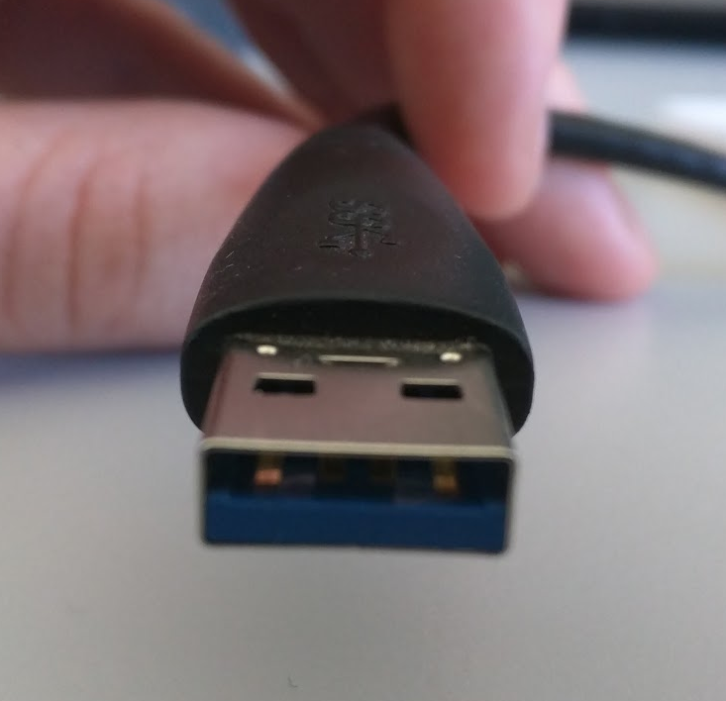
USB
kinect
Notes:
I think the reason behind this design is because the kinect requires more power than what a USB port can provide.

Slide 54
USB
kinect
5 V
12 V
Notes:
A USB can provide a 5 volt power supply, but the kinect requires 12 volts.
So I’m guessing Microsoft made the shape slightly different
so that the end user wouldn’t have a go at trying to plug it into a USB port
and wonder why the Kinect won’t work after they’ve finished forcing it in place.

Slide 55
This doesn’t fit
Notes:
But just to recap,
What this is, is an instant a barrier.
If someone wanted to give programming the kinect a go,
they would be immediately blocked .
because I doubt their machine would have the right port for this either.
If you were lucky and bought a kinect with a first generation Xbox 360, then the power adaptor did come with it..

Slide 56
This doesn’t fit
:’(
Notes:
But this plug wasn’t going to fit into any port on my laptop. So I needed to find an adaptor.

Slide 57
Requirements:
OS - windows 7/8
IDE: Kinect projects like WPF applications, so Visual Studio 2010 upwards.
Language: C# or C++
SETUP
Library: Microsoft Kinect 1.0 Beta2 SDK drivers - USE THIS ONE
http://www.microsoft.com/en-us/download/details.aspx?id=27876
(works with kinect for xbox360. Uses the microsoft.research.kinect.dll, what rainscape is using).
DO NOT plug in the kinect until the SDK has been fully installed.
Once installed,
Install Visual Studio 2010 Express to get the following (once installed, you don’t need to do anything else)
.NET 4 - comes automatically with VS 2010 express
ASP.NET MVC 4 framework
Notes:
FINALLY - through trial and error, I had managed to get the kinect setup and example code building on my laptop.
I’d been jotting down “do’s” and “don’ts” as I went like
“USE THIS ONE” and
“DO NOT PLUG THE KINECT IN UNTIL THE SDK HAS BEEN FULLY INSTALLED”.
There were a few session of installing and uninstalling drivers,
so I’m just going to leave this slide here with a bit more detail in case anyone is interested and wants to find this later.

Slide 58
Everything plugged in
Drivers installed
Time to fire up the test code...
Notes:
Now that everything’s plugged in and

Slide 59
Everything plugged in
Drivers installed
Time to fire up the test code...
Notes:
all the required drivers are installed…..
(Hopefully..)

Slide 60
Everything plugged in
Drivers installed
Time to fire up the test code...
Notes:
it was time to fire up the test code!

Slide 61
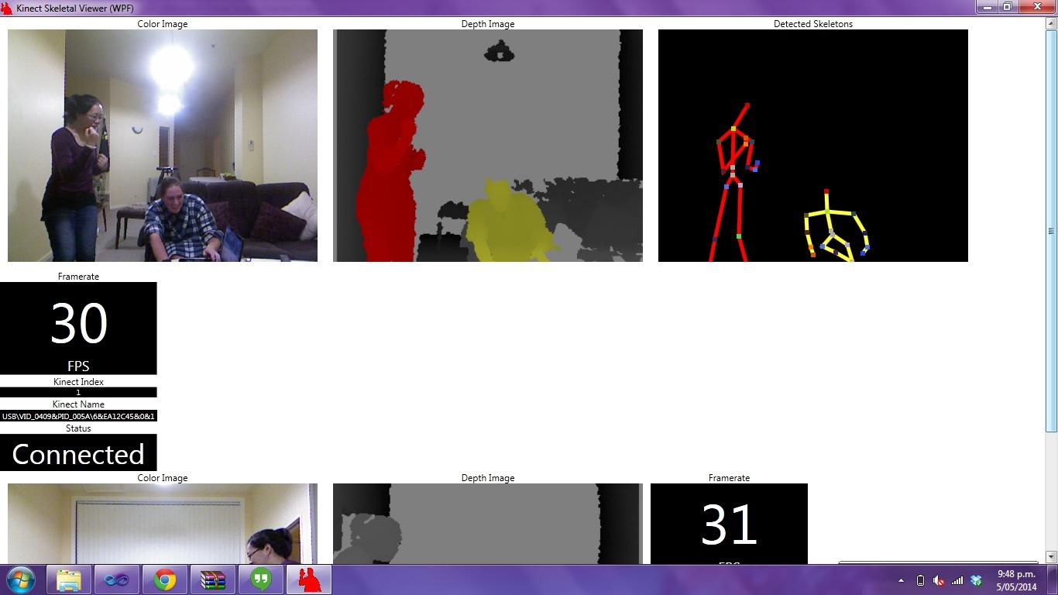
Notes:
Booyah! Success in my pjs! I successfully ran the Kinect test application which displayed the 3 views,
RGB, Depth and detected skeletons..
It also showed the number of frames per second it was able to process.

Slide 62
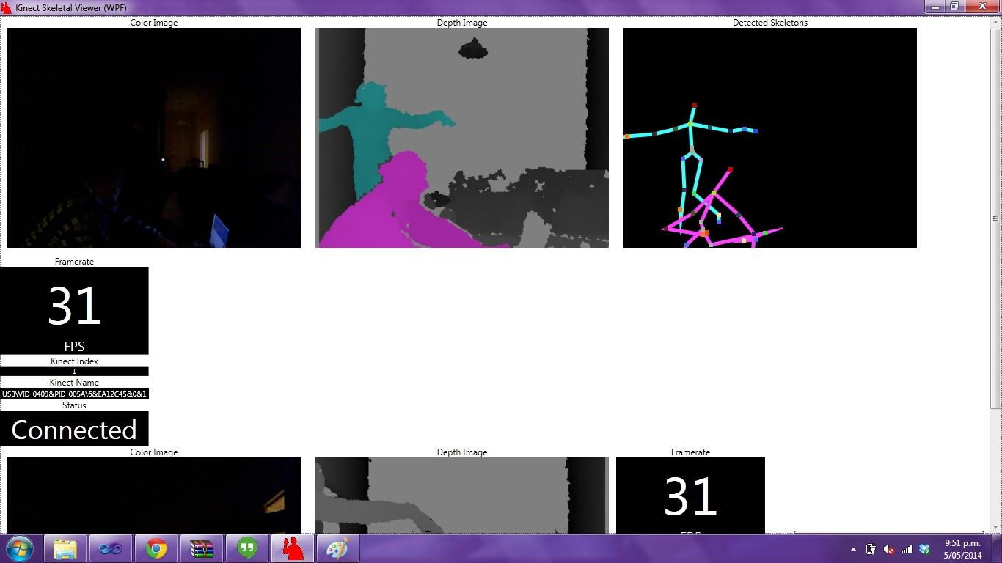
Notes:
Here is the same UI but run while the rooms lights are turned off.
Back to the x,y cross reference idea.
We wanted accuracy. This required the Kinects to have as much coverage of the space as possible
as we did not want the people moving through the space to create blind spots.
I set up the kinects so that they were at right angles from each other to see
1- what would happen to the views? and
2- could my laptop handle processing two kinects at a time?!
The result - yes, my laptop could easily handle 2 kinects (for the Kinect test application at least),
but the depth views became much more fuzzy around the edges of objects.
The depth views are constructed using the depth given back from the infrared camera.
They were a little fuzzy by themselves,
but when the cameras projected infrared paths were overlapped,
they became much worse.
One trick I read, was to add a consistent vibration to the kinect,
which would cause the emitted light to travel in a different wave to the other
and this way,
interfere less with the other light source.
In theory!

Slide 63
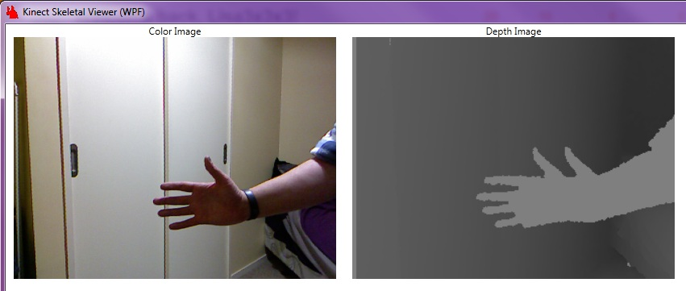
Notes:
Even when I thought I had it all figured out, the kinect would throw something new at me.
I still have no idea how I ended up with two thumbs in
the depth image here..
{CLICK}

Slide 64
Notes:
{PAUSE}
What I think it’s doing, is it’s trying to keep track of 2 layers, in case a human enters the space.

Slide 65
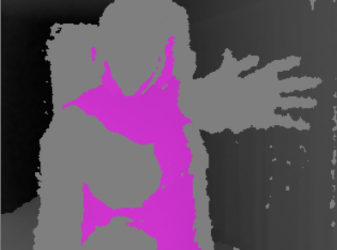
Notes:
in this image, I am very close to the camera.
What has already been identified as part of a human object, has been rendered in pink.
My hand that is very close to the camera,
has a visible 6th finger alongside my thumb.
But as I move away and the human object is re-rendered...

Slide 66
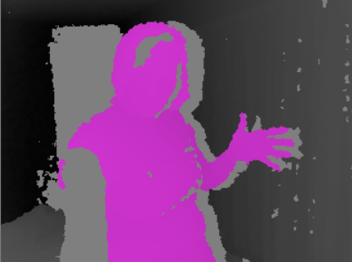
Notes:
the hand becomes part of the detected human object again.
Although, we can still see the silhouette of the second hand behind my pink one.

Slide 67
?
Notes:
Now that I understood how the kinect worked and identified some of its oddities,
how was I going to build an interactive rainstorm from this?

Slide 68
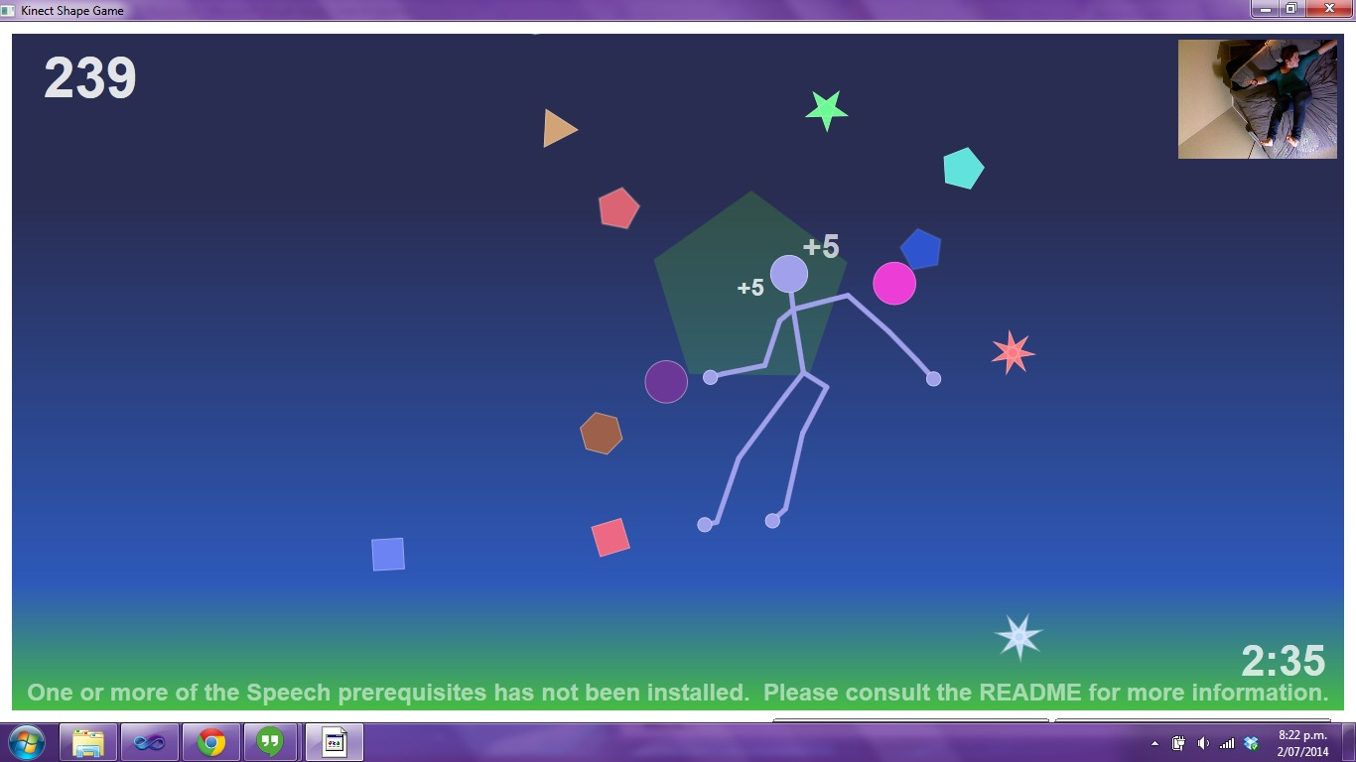
Notes:
I wanted to find solid working examples of interfacing with the kinect,
but there didn’t seem to be anything available.
The only good example I found was the Kinect shape game
Pictured here.
This came with the beta SDK I downloaded.
The shape game example was using simple collision detection
based on the skeleton object that the kinect detected.

Slide 69
Person Object
Skeleton Object
Notes:
???
But was I was still overcomplicating it?
Did I need to use the given person or skeleton objects at all?
I decided the easiest way we would be able to monitor the space inside the shipping container….
{CLICK}

Slide 70
Kinect
Notes:
would be from above.
The kinect would have to look into the space from a birds eye view.
This meant I wasn’t going to be able to use the detected person or the skeleton objects from the depth viewer.
I would have to build the motion detection from scratch.

Slide 71
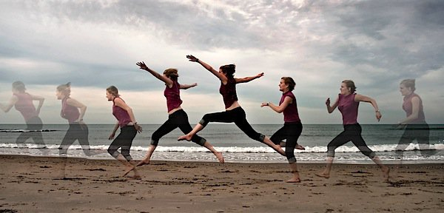
image source: http://digital-photography-school.com/
A beginners guide to capturing motion in your photography/
Notes:
But what is motion and how do we determine it?
img: http://digital-photography-school.com/a-beginners-to-capturing-motion-in-your-photography/

Slide 72
TIME
image source: http://digital-photography-school.com/
A beginners guide to capturing motion in your photography/
Notes:
In physics, motion is a change in position of an object with respect to time.
Motion is typically described in terms of displacement, distance, velocity, acceleration, time and speed.

Slide 73
Option 1.
Option 2.
compare to the
1st frame
compare the previous to the next frame
Notes:
There are a couple of approaches we could take to determining motion in our code,

Slide 74
Option 1.
Option 2.
compare to the
1st frame
compare the previous to the next frame
Notes:
Option 1. Compare every new frame to the first frame taken.

Slide 75
1st Frame
Notes:
In this option every subsequent frame after the first
is compared to it to see if it has changed.
The only problem with this approach is;

Slide 76

1st Frame
Notes:
what if something was passing through the very first frame..

Slide 77
2nd
3rd
4th
1st Frame
Notes:
and is no longer there while the application is running?
This method would give us a false indicator that motion had occurred in every frame afterwards

Slide 78
Option 1.
Option 2.
compare to the
1st frame
compare the previous to the next frame
Notes:
A better approach would be Option 2.
Compare the previous to the next frame

Slide 79
1st Frame
Notes:
In this method,
we would store the values for the current frame,
and then compare those to the next frame.

Slide 80
2nd
3rd
4th
1st Frame
Notes:
If the value in the new frame is different to the previous,

Slide 81
2nd
3rd
4th
1st Frame
Notes:
then motion has occurred.
If the value has not changed,

Slide 82
2nd
3rd
4th
1st Frame
Notes:
then no motion has occurred at that point.
troll img: https://code.google.com/p/karanvir-productions/downloads/detail?name=il1jaw.gif

Slide 83
Frame 1
Frame 2
Frame 30
Notes:
We should be able to apply this before and after comparison to our kinects depth view image frames.
The depth viewer returns roughly 30 frames per second.
If we loop through each depth frame, read the depth value of each pixel in each frame,
and compare the two, we should be able to detect motion.

Slide 84
private void Window_Loaded(object sender, EventArgs e) {
KinectStart();
/* Some initialization checks */
ImageFrame imageFrame = _kinect.DepthStream.GetNextFrame(100);
KinectAllFramesReady(null,
new ImageFrameReadyEventArgs {ImageFrame = imageFrame});
}
Notes:
Let’s jump into the code.
I used the WPF shape game example that came with the SDK to help me get my setup going.
There are a few other pretty important methods,
like “initialise kinect services”,
but we’re going to skip those and dive straight into the
Kinect All Frames Ready method.

Slide 85
private void Window_Loaded(object sender, EventArgs e) {
KinectStart();
/* Some initialization checks */
ImageFrame imageFrame = _kinect.DepthStream.GetNextFrame(100);
KinectAllFramesReady(null,
new ImageFrameReadyEventArgs {ImageFrame = imageFrame});
}
Notes:
This method is called with a new
Image Frame Ready Event Argument
which contains our current Image frame from our kinects depth stream.

Slide 86
public void KinectAllFramesReady(object sender, ImageFrameReadyEventArgs e)
{ ImageFrame imageFrame = e.ImageFrame;
}
Notes:
Now we have access to each frame.

Slide 87
public void KinectAllFramesReady(object sender, ImageFrameReadyEventArgs e)
{ ImageFrame imageFrame = e.ImageFrame;
}
public class ImageFrame
{
public int FrameNumber;
public PlanarImage Image;
public ImageResolution Resolution;
public long Timestamp;
public ImageType Type;
public ImageViewArea ViewArea;
public ImageFrame();
}
Notes:
The image frame contains a Planar Image type which is where the depth information is stored in a bytes array.
Oh and another FUN FACT:
The great thing about using a beta SDK, is that it’s not a true representation of what the final product will be.
I’m pretty sure the PlanarImage type only exists in the beta versions.
It was removed in the following release.
So this type is only relevant to us right now for defining where the depth information is kept.
Which leads me to my next point. I want to detect motion.
I don’t necessarily need to know all this information EVERY TIME an image frame is returned.
I just need the depth information at the current pixel.

Slide 88
public class Pixel { /// <summary> /// Id of the Pixel /// </summary> public int PixelId { get; set; }
/// <summary> /// Depth value returned for the current pixel /// </summary>
public int DepthValue { get; set; }
}
Notes:
so I created a Pixel class to keep a record of the
pixel Id and the
depth value for the given pixel

Slide 89
var pixelDepthValue = imageFrame.Image.Bits[GetOffsetFromXY(x, y, imageFrame.Image.BytesPerPixel)];
var pixel = new Pixel(); pixel.PixelId = pixelCounter; pixel.DepthValue = pixelDepthValue;
//Add the pixel to our Pixel list
PixelList.Add(pixel);
Notes:
now I that I had a type to contain the pixel information,
I could easily loop through the frames and keep track of a list of pixels and their values.
This code snippet is from a nested for loop,
looping through the pixels of a planar image.

Slide 90
var pixelDepthValue = imageFrame.Image.Bits[GetOffsetFromXY(x, y, imageFrame.Image.BytesPerPixel)];
var pixel = new Pixel(); pixel.PixelId = pixelCounter; pixel.DepthValue = pixelDepthValue;
//Add the pixel to our Pixel list
PixelList.Add(pixel);
Notes:
We created a function to get the offset depth value from the given XY coordinates.
This method took into account the number of bytes per pixel and worked out a more accurate
integer value to represent our pixels depth value.

Slide 91
var pixelDepthValue = imageFrame.Image.Bits[GetOffsetFromXY(x, y, imageFrame.Image.BytesPerPixel)];
var pixel = new Pixel(); pixel.PixelId = pixelCounter; pixel.DepthValue = pixelDepthValue;
//Add the pixel to our Pixel list
PixelList.Add(pixel);
Notes:
while looping through each row and column of an image,
we created a new pixel object,
incremented a counter to assign to our new pixel Id
and associated the returned offset pixelDepthValue to our new objects depth value.

Slide 92
var pixelDepthValue = imageFrame.Image.Bits[GetOffsetFromXY(x, y, imageFrame.Image.BytesPerPixel)];
var pixel = new Pixel(); pixel.PixelId = pixelCounter; pixel.DepthValue = pixelDepthValue;
//Add the pixel to our Pixel list
PixelList.Add(pixel);
Notes:
Then that pixel object is added to our current list of pixels.
Now the next frame that comes in can iterate through the same process,
create a new list of pixels
and can now be compared to our current Pixel List!
If the depth values are different between our lists,
then we will consider motion to have occurred at that point in the frame!

Slide 93
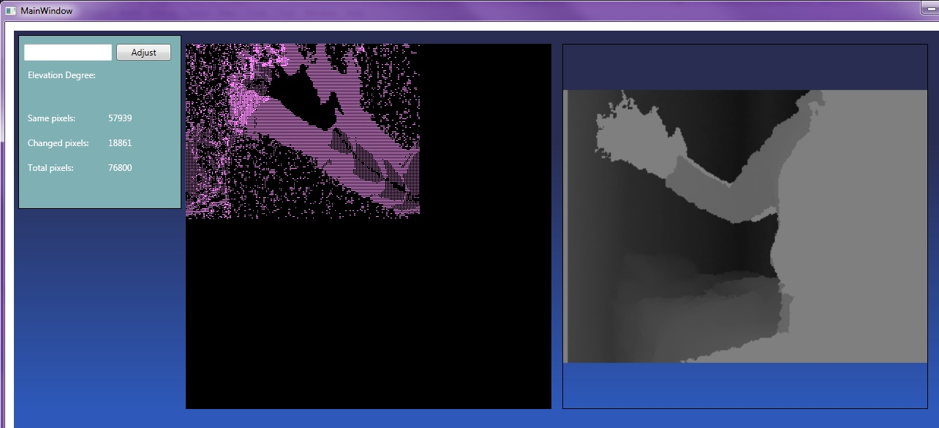
Depth viewer
Notes:
So now when I wave to the kinect

Slide 94
“oh hai”
Depth viewer
Notes:
the depth viewer sends back a new image frame

Slide 95
*waves*
“oh hai”
Depth viewer
Notes:
that we loop through and
compare to our list of previous pixels and their depth values

Slide 96
MOTION!
Depth viewer
Notes:
And there we have it! Motion detected! And lots of it!
Here my hand is waving up and down,
and we can clearly see that because of the dense colouring of motion detected around the edges of my arm.

Slide 97
MOTION!
Depth viewer
Notes:
and of course, I still have two thumbs on that hand.

Slide 98

MOTION!
Depth viewer
Notes:
troll - take a drink

Slide 99
MOTION!
Depth viewer
Notes:
So this has worked, but it’s certainly not perfect.
The result is very noisy.
Not audibly noisy, but bouncy noisy.
The infrared light is reflecting off of other items in the space.
So some of the returned depth values are slightly different each time, even when no motion has occurred at that point.
I needed a way to cancel out or ignore the noisy infrared responses.

Slide 100
Option 1.
Option 2.
Notes:
I saw two options for doing this.

Slide 101
Option 1.
Option 2.
Notes:
Option 1. Motion is essentially the change in position over time,
so I could implement a buffer queue
and over a certain amount of time,
if the change in the depth value for a particular pixel isn’t very much,
then we won’t consider that to be motion.
But if the change to the depth is quite substantial over a certain amount of time,
then we should consider that as motion.
This should cancel out any random blips on our kinects radar and give us a closer representation of motion.

Slide 102
Option 1.
Option 2.
Notes:
The other option is to check the pixels surrounding a given pixel
and compare their depth values to our current pixels depth value.
Then if those combined values were different on the next few frames,
we should consider that as motion.

Slide 103
Option 1.
Option 2.
Notes:
The second option would give us a more clearer representation of where motion had occurred.
But I wanted a quick win

Slide 104
Option 1.
Option 2.
Notes:
so opted to use a buffer queue and compare my pixel values over the last 10 frames to determine if motion had occurred.

Slide 105
public class Pixel { /// <summary> /// Id of the Pixel /// </summary> public int PixelId { get; set; }
/// <summary> /// Buffer /// IR makes a lot of noise when it bounces off of certain objects. /// We will use a buffer to weed out the noise /// </summary> public Queue<int> BufferQueue { get; set; }
}
Notes:
By replacing the depth value with a bufferQueue in our pixel class,
we could now associate a range of depth values to one pixel,
by dequeuing and enqueuing the buffer queue.

Slide 106
foreach (var pixel in PixelList) { //Empty list to hold our depth values for comparing for duplicates List<int> thisPixelsValues = new List<int>(); //Foreach through the queue for current pixel foreach (var depthValue in PixelList[pixel.PixelId].BufferQueue) { if (thisPixelsValues.Contains(depthValue)) { sameCounter++; } thisPixelsValues.Add(depthValue); }
Notes:
now when we’re looping through, we’re not just comparing the previous frames values,

Slide 107
foreach (var pixel in PixelList) { //Empty list to hold our depth values for comparing for duplicates List<int> thisPixelsValues = new List<int>(); //Foreach through the queue for current pixel foreach (var depthValue in PixelList[pixel.PixelId].BufferQueue) { if (thisPixelsValues.Contains(depthValue)) { sameCounter++; } thisPixelsValues.Add(depthValue); }
Notes:
but the previous 10 frames depth values
stored in the bufferQueue

Slide 108
foreach (var pixel in PixelList) { //Empty list to hold our depth values for comparing for duplicates List<int> thisPixelsValues = new List<int>(); //Foreach through the queue for current pixel foreach (var depthValue in PixelList[pixel.PixelId].BufferQueue) { if (thisPixelsValues.Contains(depthValue)) { sameCounter++; } thisPixelsValues.Add(depthValue); }
Notes:
We start by creating an empty list of integers called thisPixelsValues

Slide 109
foreach (var pixel in PixelList) { //Empty list to hold our depth values for comparing for duplicates List<int> thisPixelsValues = new List<int>(); //Foreach through the queue for current pixel foreach (var depthValue in PixelList[pixel.PixelId].BufferQueue) { if (thisPixelsValues.Contains(depthValue)) { sameCounter++; } thisPixelsValues.Add(depthValue); }
Notes:
if this list contains the same depth value we’re foreaching on from the buffer queue,
then we increment the “same counter”.
And then we add that depth value to our pixelValues list.

Slide 110
// If we counted more duplicates than our
// NoiseBufferAllowance allows for, // then we're not counting this as motion. It's just noise. if (sameCounter > _noiseBufferAllowance) { //ignore the noise!
} else { //Motion occurred at this Pixel!
Notes:
the same counter is then compared to our Noise buffer allowance.

Slide 111
// If we counted more duplicates than our
// NoiseBufferAllowance allows for, // then we're not counting this as motion. It's just noise. if (sameCounter > _noiseBufferAllowance) { //ignore the noise!
} else { //Motion occurred at this Pixel!
Notes:
If we counted more duplicates than our
NoiseBufferAllowance allows for, then we're not counting this as motion.
It's just noise.

Slide 112
// If we counted more duplicates than our
// NoiseBufferAllowance allows for, // then we're not counting this as motion. It's just noise. if (sameCounter > _noiseBufferAllowance) { //ignore the noise!
} else { //Motion occurred at this Pixel!
Notes:
else, motion occurred at this pixel! We should do something about that!

Slide 113
// If we counted more duplicates than our
// NoiseBufferAllowance allows for, // then we're not counting this as motion. It's just noise. if (sameCounter > _noiseBufferAllowance) { //ignore the noise!
} else { //Motion occurred at this Pixel!
Notes:
The noise buffer allowance is a variable that I’ve manually set at the beginning of the class.
It’s manually set because each environment that the kinect is set up in, will be exposed to different levels of light or reflective material.
This noise buffer allowance needs to be tested and set before leaving the application to run on it’s own.
Let’s see how much of the noise we’ve managed to clean up.

Slide 114
Notes:
previously there was a lot of scattered infrared reflections..
But now..

Slide 115
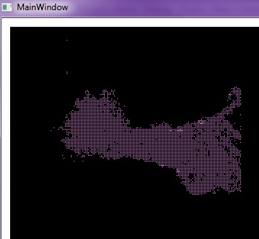
Adios noise!
Notes:
Adios noise!

Slide 116
*waves*
Adios noise!
Notes:
The buffer queue was super effective!
There was the occasional random blip here and there, but this was good enough for what we wanted.

Slide 117
Notes:
So we’ve just gone over the happy path to success.
And it’s nice to see a successful outcome,
but of course it wasn’t that easy.
I encountered a few snags along the way to kicking this noise to the curb.
I was using a bitmap image type to generate the motion detection image.
and I managed to generate a new bitmap image for every frame well enough..
But if the application was left running for roughly 2 minutes,

Slide 118
Out Of Memory :(
OutOfMemoryException
was unhandled
!
Notes:
an Out Of Memory exception would occur!
I’d somehow managed to find this weird bug with bitmap images
where the garbage collection wasn’t destroying old images while the application was running.
Eventually my RAM would run out and
Visual studio would throw the OOM exception and stop debugging.
I don’t know if this was an environment specific thing,
but I wasn’t able to get to the bottom of it.
At least I knew every time I ran the application, I had 2 minutes to test my changes!
So rendering the final animation with a bitmap image was out of the question.

Slide 119
Notes:
Early on when I was initially trying to make the pixel by pixel comparison work,
I noticed that the processing time became ridiculously long.
Like, taking several minutes, to just process 1 second or 30 frames worth of depth images.
I couldn’t figure out why it was taking so damn long.
Surely if my laptop could run the the example application with two kinects at once,
then creating a foreach loop couldn’t be consuming that much more processing power.

Slide 120
Notes:
One night while I was out for dinner with friends, all I could think about was my processing problem.
It frustrated me that I couldn’t work out how to improve the performance.
My friend notice I was frustrated by something and asked me what was wrong.
I explained my processing issue for this interactive rainstorm thing I was working on,
and of course everyone at the table is in the technology industry
so the table conversation quickly turned into a grand debate around...

Slide 121
foreach VS
parallel
Notes:
the pros and cons
of using either a foreach or parallel foreach loop.

Slide 122

Notes:
It was like one of those moments,
where “someone is wrong on the internet and I must fix this”
but in real life,
happening right now at the dinner table!
My friends are a pretty cool nerdy bunch of people.
img: https://xkcd.com/386/

Slide 123
foreach (var pixel in PixelList)
Parallel.ForEach(
PixelList, (pixel) =>
Notes:
So I went home and swapped out my foreach loop
to test a parallel.foreach loop instead and see if that made a difference.

Slide 124
//foreach (var pixel in PixelList)
Parallel.ForEach(
PixelList, (pixel) =>
Notes:
The only real difference I could tell between a parallel.foreach and the generic foreach
(other than the way it’s written)
was that a parallel foreach could run multiple threads in parallel,
whereas the foreach would iterate through the collection and may use multiple threads,
but would always return the result to the calling thread. So it would always stay on one.

Slide 125
Parallel.ForEach(
PixelList, (pixel) =>
Notes:
The new parallel foreach seem to be slightly faster, though not enough to fix my issue.
And based on the count information I was logging,
the new loop was skipping some comparisons,
so it was never going to be checking the PixelList as accurately as I wanted it to be..
…
Then it dawned on me...
Did anyone else just pick up on what I said?
..

Slide 126
Parallel.ForEach(
PixelList, (pixel) =>
// logic
// some more logic
// even more logic here
Log.Info(“Result = ” + ...
Notes:
I had a call to log the output to a text file within the loop.
Meaning that each time it looped through,
it had to open a file,
write to it, save and close it.
As soon as I removed my logging, everything worked much faster!
The responses seemed to be near real time.
So

Slide 127

Why log when you could not?
Notes:
why log when you could not?
Obviously I’m not against logging,
I was just annoyed that what I had been considering a major issue had such a simple fix.
img: http://giphy.com/gifs/troll-you-mad-face-eVy46EWyclTIA

Slide 128
Notes:
But anyway,
Now that we’ve achieved motion detection as a buggy bitmap image...

Slide 129
Notes:
How are we going to render this as a rainstorm?

Slide 130
Notes:
When I think of rain, I think of the soft droplets falling randomly.
They are sporadic. Never falling in quite the same place twice. Each a different density than the last.
So the next challenge was to mimic the behaviour of nature.
This wasn’t even going to be the hardest part of my next challenge.
My poor little laptop was starting to sound like a server rack!
Processing 307,200 pixels roughly 30 times a second, was taking a toll on its tiny i5 processor.

Slide 131
why not
Javascript?
Notes:
I tried running up a second C# application to handle the rendering. Figuring this might at least separate the threads processing the information. But this only made things worse.
There had to be a simpler way. Something lightweight,that could handle the animation.
{click}
Then I thought,
Why not javascript?

Slide 132
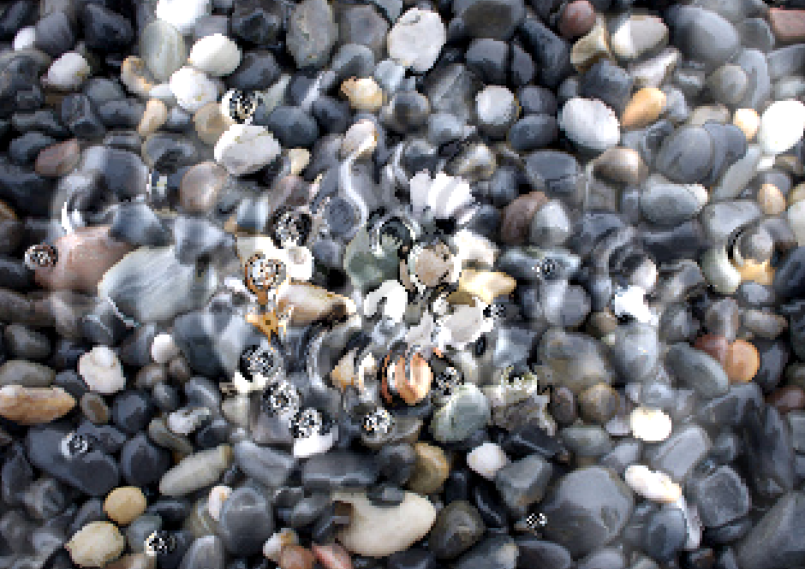
HTML5 Water Ripples
image source: http://29a.ch/2010/10/23/html5-water-ripples-demo
HTML5 Water Ripples Demo - Written by Jonas Wagner
Notes:
I had a hunt around online and found a really cool water ripple example created by Jonas Wagner.
The example used an HTML 5 canvas to render ripples randomly across the screen.

Slide 133
function disturb(x, y, z){ if(x < 2 || x > width-2 || y < 1 || y > height-2) return; var i = x+y*width; buffer0[i] += z; buffer0[i-1] -= z; }
Notes:
The way it currently worked, was by calling the function disturb(), and randomizing different X Y coordinates to render on the canvas.
The Z parameter was to indicate the droplet size.

Slide 134
for(i=width+1;i<size-width-1;i+=2){ for(x=1;x<width-1;x++,i++){ // wave propagation var waveHeight = (buffer0[i-1] + buffer0[i+1] + buffer0[i+width] + buffer0[i-width])/2-buffer1[i]; buffer1[i] = waveHeight; // calculate index in the texture with some fake referaction var ti = i+floor((buffer1[i-2]-waveHeight)*0.08)+floor((buffer1[i-width]-waveHeight)*0.08)*width; // clamping ti = ti < 0 ? 0 : ti > size ? size : ti; // some very fake lighting and caustics based on the wave height // and angle var light = waveHeight*2.0-buffer1[i-2]*0.6, i4 = i*4, ti4 = ti*4; // clamping light = light < -10 ? -10 : light > 100 ? 100 : light; data[i4] = texture.data[ti4]+light; data[i4+1] = texture.data[ti4+1]+light; data[i4 + 2] = texture.data[ti4 + 2] + light; } }
Notes:
This then ran through a process to alter the two buffer arrays,
so that the light of each wave slowly diminished.
As if it were a ripple fading out.
There’s a lot of rad processing and complex logic going on here!
Just to be clear, I did not write this logic for creating a ripple on an html canvas, so full props go to Jonas Wagner for this.

Slide 135
function disturb(x, y, z){ if(x < 2 || x > width-2 || y < 1 || y > height-2) return; var i = x+y*width; buffer0[i] += z; buffer0[i-1] -= z; }
Notes:
So I called this function to create a new wave propagation that would create only one droplet effect when called.
I did make one slight modification for a little easter egg, but if you’re good, I’ll let you in on that later.
The user's interaction in rainscape is to be reflective of their movements,
I needed the droplet to form at the coordinates where motion had occurred.
For this, I create a dynamic grid.

Slide 136

Notes:
The grid is constructed in CSS and setup to split the display into a 100 sections.
10 rows and 10 columns.
I then applied the same 10x10 grid in the C# application across the depth stream view.

Slide 137
Notes:
The same style grid meant that I could now reference row 5, column 5 in the code,
and it would correlate to the same section on the HTML5 canvas.
This meant that when motion was detected at a certain pixel,
I would know which section on the canvas needed to render the animation.
The displayed labels are the Ids of each section.
They’re a combination of the row# and column# so that each could be addressed uniquely.
Obviously, this is going to be invisible to the user. They will never know it exists
Now, I know what you’re thinking
“That’s great lisa, but how are you going to call javascript functions from a desktop application?”
Well, I’m glad you asked. I used SignalR.

Slide 138
ASP.NET SignalR
client
server
client
client
Notes:
SignalR is an ASP.NET library that allows us to add real-time web functionality to our websites.
By using websockets, it enables bidirectional communication between our browser and server.

Slide 139
ASP.NET SignalR
client
server
client
client
Notes:
Meaning, that the server can push updates to the clients browsers

Slide 140
ASP.NET SignalR
client
server
client
client
Notes:
and they can send messages back to potentially update other listeners, in real-time.
I decided to use SignalR because it could maintain an open connection
and
it promoted that it could cope with high frequency updates from the server,
the likes required for real-time gaming.
The most common example and way to get started with signalR is by using it to implementing a basic chat client.
Which is exactly what I followed to get the same push notification functionality in Rainscape

Slide 141
rainscape
WPF
Notes:
Because the Rainscape solution is a WPF application,

Slide 142
OWIN
rainscape
Open Web Interface for .NET
WPF
Notes:
I needed to modify it slightly to be able to spin up a OWIN self hosted site
so that it could use SignalR to broadcast messages.

Slide 143
OWIN
Open Web Interface for .NET
Notes:
OWIN is an Open Web Interface for .NET
It defines a standard interface between .NET web servers and web applications.
OWIN allows us to decouple our web applications from the server,
which makes it ideal for self-hosting a web application
in it’s own process outside of IIS

Slide 144
public class SignalHub : Hub {
public static void Send(string cellId) { var context =
GlobalHost.ConnectionManager.GetHubContext<SignalHub>();
context.Clients.All.broadcastMessage(cellId); }
Notes:
Firstly, the next few slides are a bit code heavy, but trust me.
Adding in SignalR is super easy.
I created a new SignalHub class to handle broadcasting the send notification message

Slide 145
public class SignalHub : Hub {
public static void Send(string cellId) { var context =
GlobalHost.ConnectionManager.GetHubContext<SignalHub>();
context.Clients.All.broadcastMessage(cellId); }
Notes:
The Send method passes through the cellId
of the section that I want to update on the HTML canvas

Slide 146
public class SignalHub : Hub {
public static void Send(string cellId) { var context =
GlobalHost.ConnectionManager.GetHubContext<SignalHub>();
context.Clients.All.broadcastMessage(cellId); }
Notes:
by setting up a SignalHub Hub context

Slide 147
public class SignalHub : Hub {
public static void Send(string cellId) { var context =
GlobalHost.ConnectionManager.GetHubContext<SignalHub>();
context.Clients.All.broadcastMessage(cellId); }
Notes:
we can then broadcast the message to all the available clients

Slide 148
//--SignalR setup--------------------------------------------- public IDisposable SignalR { get; set; } const string ServerURI = "http://localhost:5648";
private void StartServer() {
using (SignalR = WebApp.Start<Startup>(ServerURI)) { while (true) { } }
Notes:
then in the main class,
I created a new IDisposable object called SignalR,
to maintain the resources for our OWIN self hosted website

Slide 149
//--SignalR setup--------------------------------------------- public IDisposable SignalR { get; set; } const string ServerURI = "http://localhost:5648";
private void StartServer() {
using (SignalR = WebApp.Start<Startup>(ServerURI)) { while (true) { } }
Notes:
this is then started in our private StartServer method
that’s called asynchronously when the main application starts up.
This will keep our site running while the application is running.

Slide 150
SignalHub.Send(cellId);
Notes:
finally, when I want to broadcast the update,
I just call SignalHub.Send( my message );
For rainscape, I just wanted to update where motion had occurred.
So the string message only needed to contain the Id of the section to update.
Great! Now how do we make the clients listen for this message?

Slide 151
<!--Script references. --> <!--Reference the jQuery library. --> <script src="/html/Scripts/jquery-1.6.4.min.js" ></script> <!--Reference the SignalR library. --> <script src="/html/Scripts/jquery.signalR-1.1.4.js"></script> <!--Reference the autogenerated SignalR hub script. --> <script src="/signalr/hubs"></script>
<!--Add script to update the page and send messages.--> <script type="text/javascript">
<!--do stuff...-->
Notes:
On the client side, we set up all our references to jquery and signalR including the hub scripts.
Pretty stock standard stuff.

Slide 152
<script type="text/javascript"> $(function () { // Declare a proxy to reference the hub. var signalHubConnection = $.connection.signalHub; // Create a function that the hub can call to broadcast messages. signalHubConnection.client.broadcastMessage = function (cellId) { //rainscape signalHub will send grid div Id to this function //We work out the relative location based on the Id. }; // Start the connection. $.connection.hub.start().done(function() { }); }); </script>
Notes:
Then in our javascript,

Slide 153
<script type="text/javascript"> $(function () { // Declare a proxy to reference the hub. var signalHubConnection = $.connection.signalHub; // Create a function that the hub can call to broadcast messages. signalHubConnection.client.broadcastMessage = function (cellId) { //rainscape signalHub will send grid div Id to this function //We work out the relative location based on the Id. }; // Start the connection. $.connection.hub.start().done(function() { }); }); </script>
Notes:
we declare our connection,
a proxy to reference the hub,

Slide 154
<script type="text/javascript"> $(function () { // Declare a proxy to reference the hub. var signalHubConnection = $.connection.signalHub; // Create a function that the hub can call to broadcast messages. signalHubConnection.client.broadcastMessage = function (cellId) { //rainscape signalHub will send grid div Id to this function //We work out the relative location based on the Id. }; // Start the connection. $.connection.hub.start().done(function() { }); }); </script>
Notes:
create a function that the hub can call to broadcast message,

Slide 155
<script type="text/javascript"> $(function () { // Declare a proxy to reference the hub. var signalHubConnection = $.connection.signalHub; // Create a function that the hub can call to broadcast messages. signalHubConnection.client.broadcastMessage = function (cellId) { //rainscape signalHub will send grid div Id to this function //We work out the relative location based on the Id. }; // Start the connection. $.connection.hub.start().done(function() { }); }); </script>
Notes:
and then we start our connection.

Slide 156
<script type="text/javascript"> $(function () { // Declare a proxy to reference the hub. var signalHubConnection = $.connection.signalHub; // Create a function that the hub can call to broadcast messages. signalHubConnection.client.broadcastMessage = function (cellId) { //rainscape signalHub will send grid div Id to this function //We work out the relative location based on the Id. }; // Start the connection. $.connection.hub.start().done(function() { }); }); </script>
Notes:
Done. It is actually that simple.
I had never worked with signalR before but it was super easy to get set up and running really quickly.

Slide 157
<script type="text/javascript"> $(function () { // Declare a proxy to reference the hub. var signalHubConnection = $.connection.signalHub; // Create a function that the hub can call to broadcast messages. signalHubConnection.client.broadcastMessage = function (cellId) { //rainscape signalHub will send grid div Id to this function //We work out the relative location based on the Id. }; // Start the connection. $.connection.hub.start().done(function() { }); }); </script>
Notes:
The actual logic for updating the canvas is removed from this view to help save space,
but we would have called our “create rain droplet” method from within the
broadcastMessage function, and pass through the CellId provided by the WPF applicaton.

Slide 158
why not
Javascript?
Notes:
Before we asked
Why not javascript,
and now we’ve got an application running ….

Slide 159
Javascript
SignalR
OWIN
Notes:
javascript

Slide 160
Javascript
SignalR
OWIN
Notes:
signalR

Slide 161
Javascript
SignalR
OWIN
Notes:
and it’s own OWIN self hosted site.
Why not javascript indeed!
Now let’s test this thing out.

Slide 162
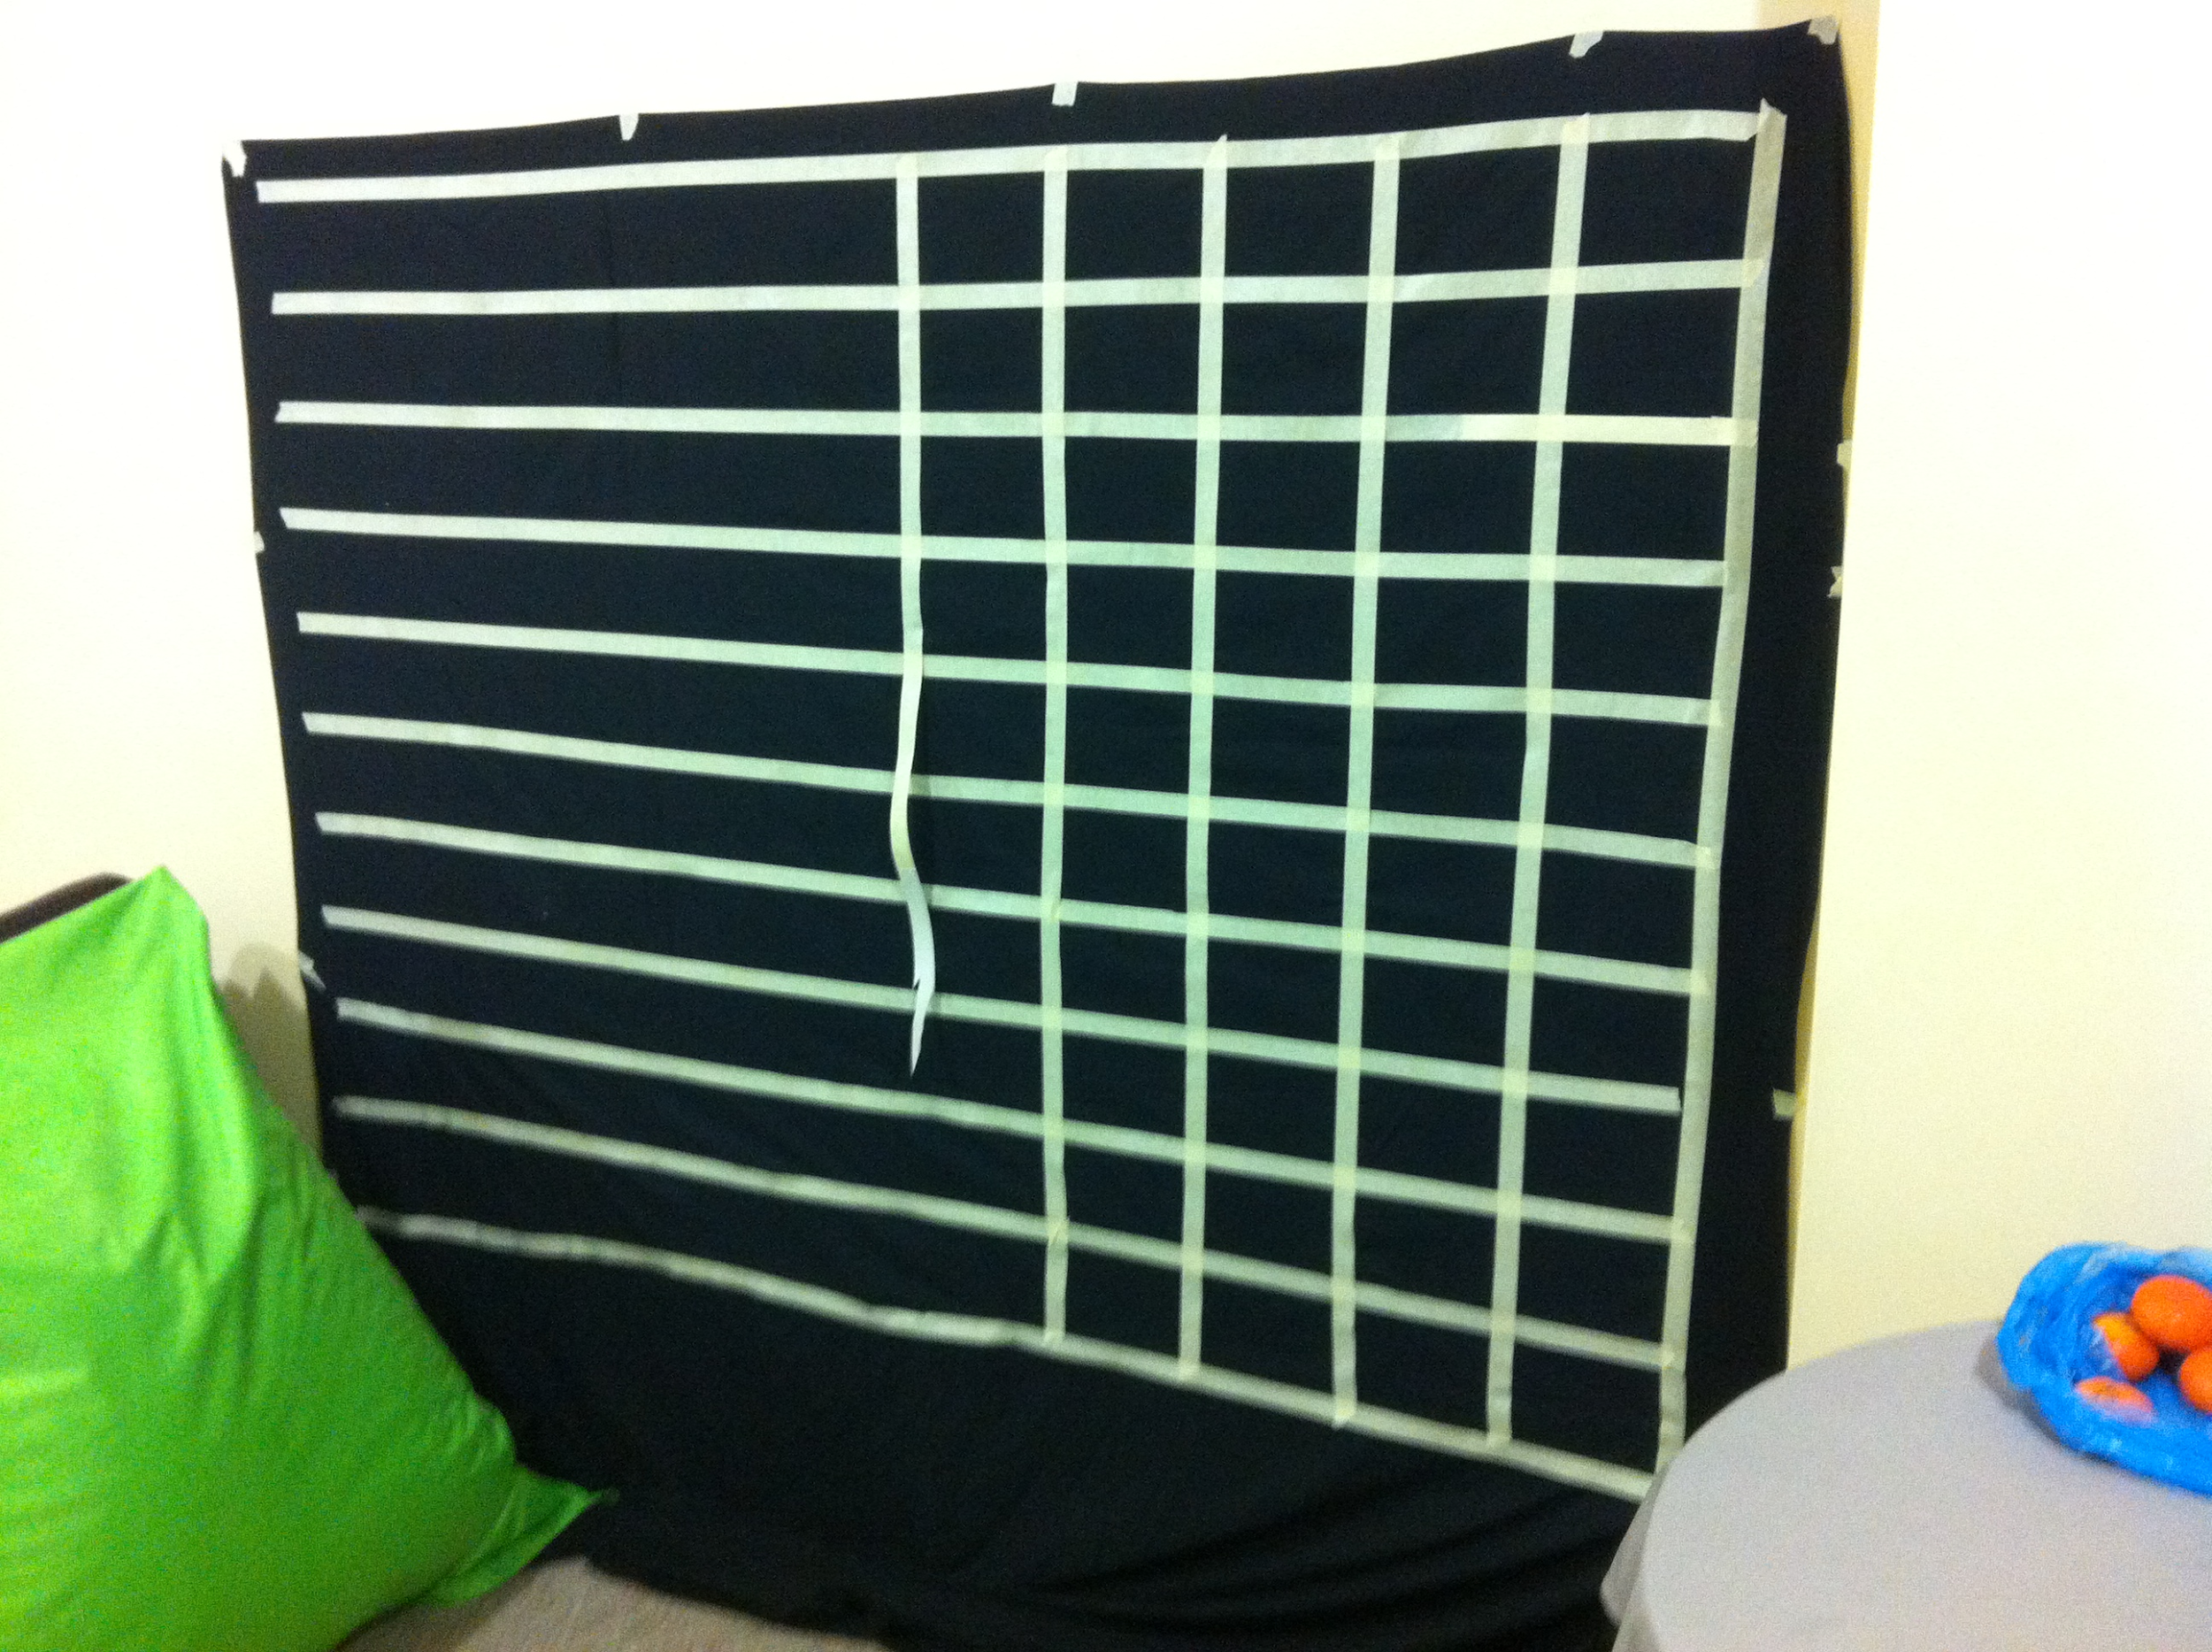
Notes:
Testing in the real world, meant testing off screen
Because of course I wrote unit tests (shakes head/sad face). I’m a bad person.
Anyway, I needed to create a real world grid to ensure that my digital grid would render where I expected it to.
Using a sheet and some masking tape,
I was able to project my CSS grid
and map out the exact sections sizes.
And of course I ran out of masking tape creating my real world grid for testing..
You can write as many lines of code as you want.
But in the real world, you need to go to the store and buy more masking tape.

Slide 163
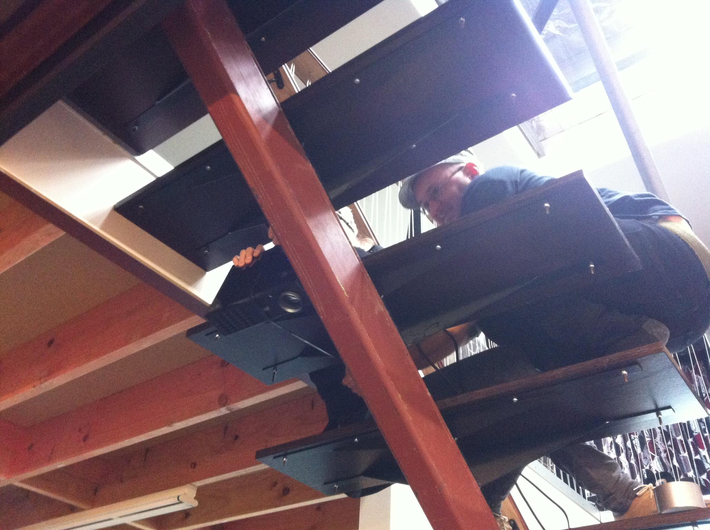
Notes:
So that covered side on testing, but we needed to test from above.
Here’s Debbie and Josh creating a projector mount on the stairs.
And of course, we’re not structural engineers, so mounting things with cable ties is absolutely fine!

Slide 164
Notes:
The final piece to the rainscape puzzle was the atmosphere.
The user had to feel
like they were part of a storm.

Slide 165
Notes:
with thunder

Slide 166
Notes:
and lightning

Slide 167
Notes:
all inside inside a shipping container..
remember that’s why we’re bringing all these components together :)

Slide 168
Notes:
To achieve this thunder and lightning, we decided to use a DMX haze machine and a DMX light.

Slide 169
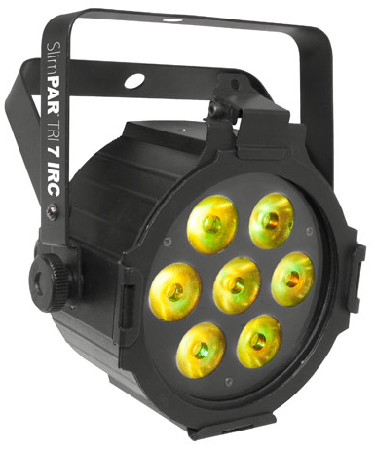
Notes:
DMX is an older protocol now and is more commonly used for stage lighting and equipment.
img: http://www.chauvetlighting.com/slimpar-tri-7-irc.html

Slide 170
CONTROLLER
SLAVE DEVICE
SLAVE DEVICE
OUT
IN
OUT
IN
TERMINATOR
Notes:
It works by essentially daisy chaining nodes together.
The first node is the controller which is the master of the network
and then there can be one or more slave devices,
with a 120 ohm resistor as the “out terminator” in the final node.

Slide 171
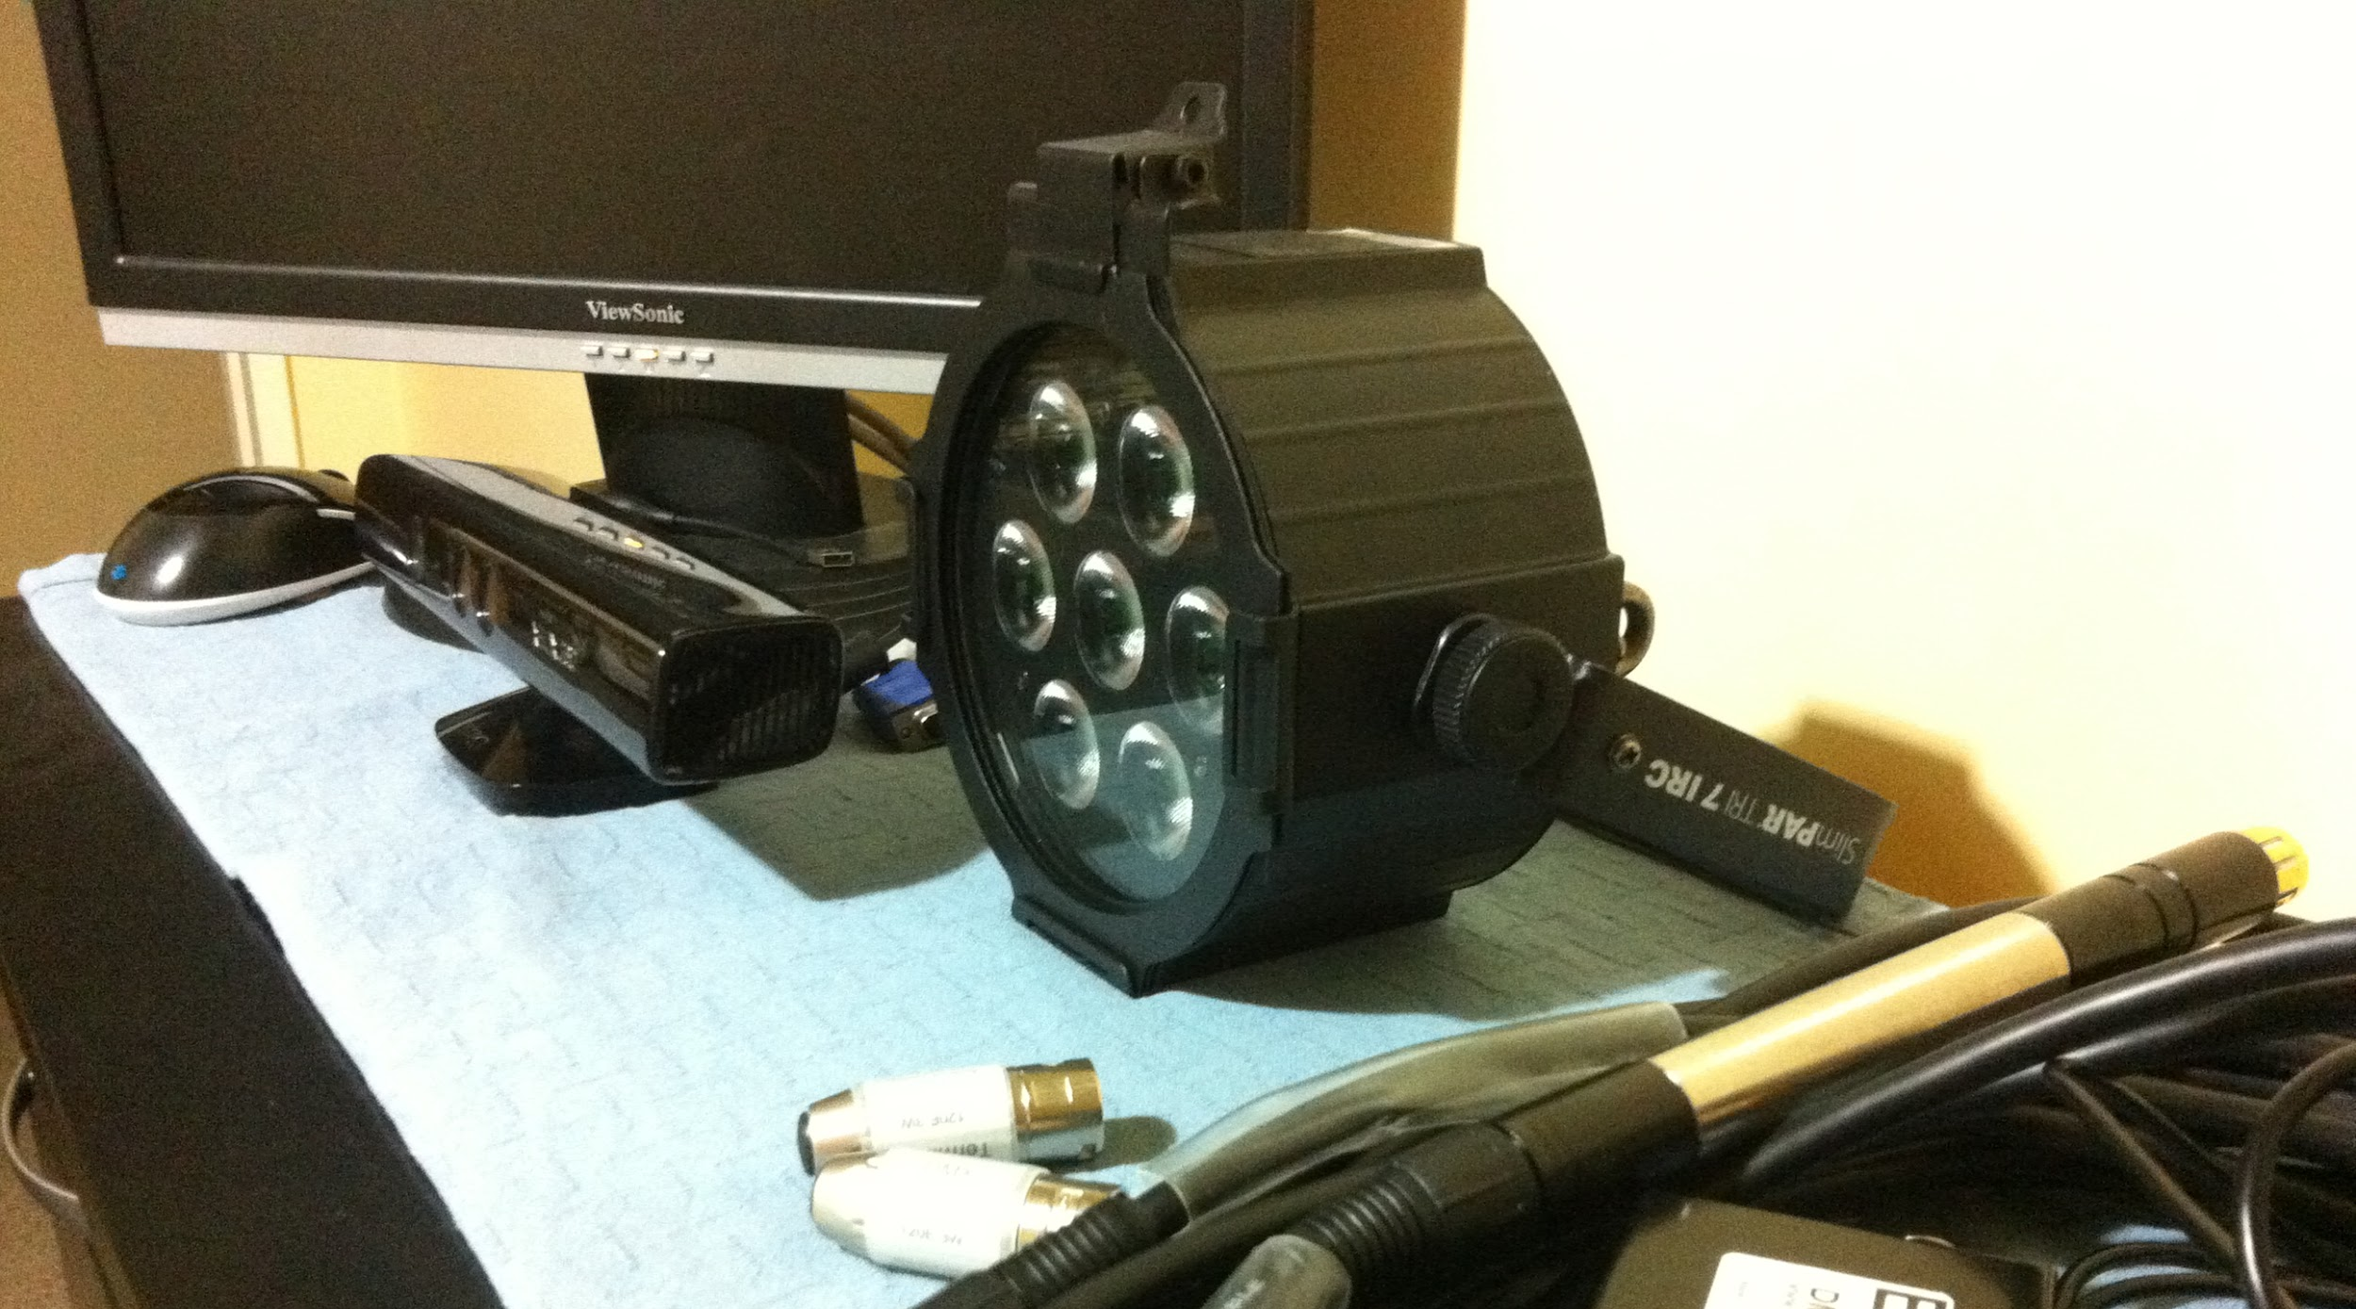
Notes:
Here’s an example of the size of the DMX light we were using compared to the kinect.
It’s not too big, but it was pretty heavy.
The example code provided by ENTTEC,
the company we bought the DMX light from,
only had a C++ console application example.
I foresaw much fun in converting C++ to C#.
For now, I pulled down the C++ example
AND

Slide 172

Notes:
RAN D M
img: http://www.legacyrecordings.com/a/#/artist/run-dmc/1158/

Slide 173
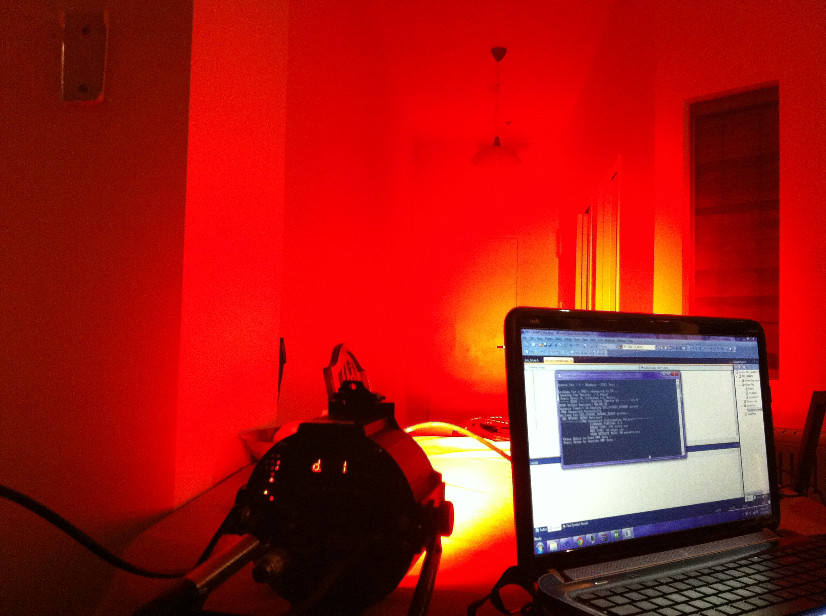
Notes:
X!
This was taken running the DMX console application and setting the light output to red and full luminosity..
There is a door at the end of this hallway.
It’s just so damn bright.
Luckily for me, good people are good!
Someone had already spent the time creating a C# DMX library.
And made it available on Github!
So thank you agrath! (I think that’s how you pronounce your username)
I’ve add a link to the Sniper.Lighting.DMX library in this slides references, so you guys can check it out later if you’re interested.
We used the library to program the light to flash on at intervals
when a backing rain and thunder storm audio track sounded like thunder was rolling.

Slide 174
Notes:
We also experimented with a DMX haze machine.
A haze machine is like a fog machine,
except it doesn’t have the same horrible smell as a fog machine.
The solution it disperses is water-based and appears to hang for a long time
which helps convey the idea that the user is in the middle of a rain cloud.
Running the same console application, we were able to turn the haze machine on...
Although, we couldn’t figure out the command to stop it.
I was sitting in Josh’s lounge, we fired up the code and haze started pumping into the room
Woohoo! It worked.. Now how do we turn it off?
Stop - End - CLose - STAAAHP - Pull the plug!
We decided the haze machine couldn’t be trusted. So for this project, it ended up just running on a timer.
Which was probably a good thing, because it filled up the container with haze really quickly.
https://github.com/agrath/Sniper.Lighting.Dmx

Slide 175
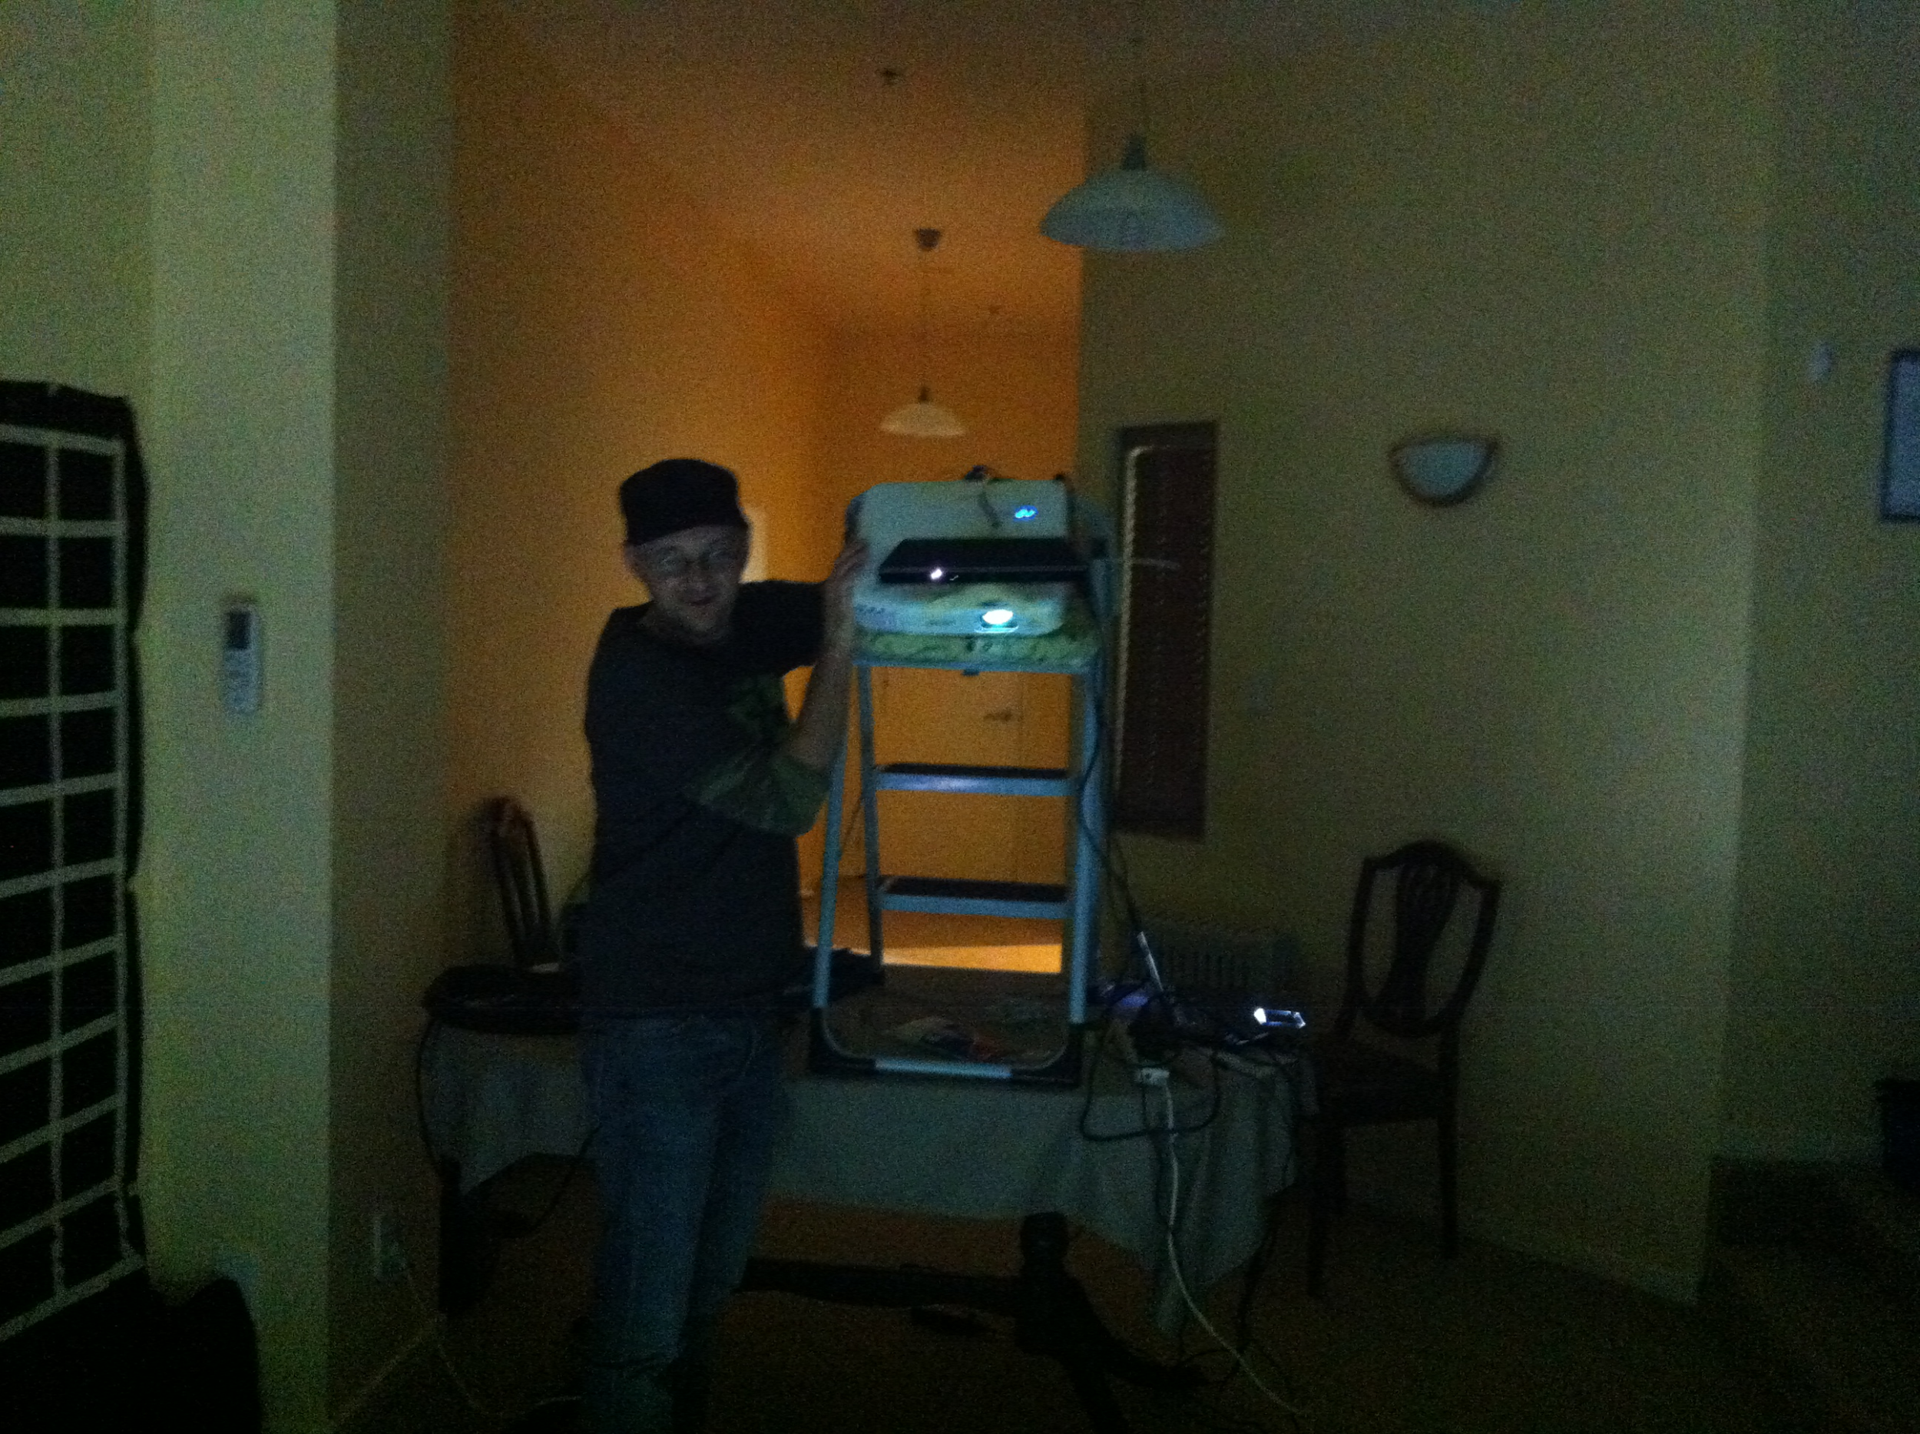
Notes:
So we’ve got all out components together now.
* fist bump *
It’s time for more testing!
And because we’re not structural engineers,
a step ladder on a table
with an ironing board for stability
and a Josh for support
is totally normal.

Slide 176
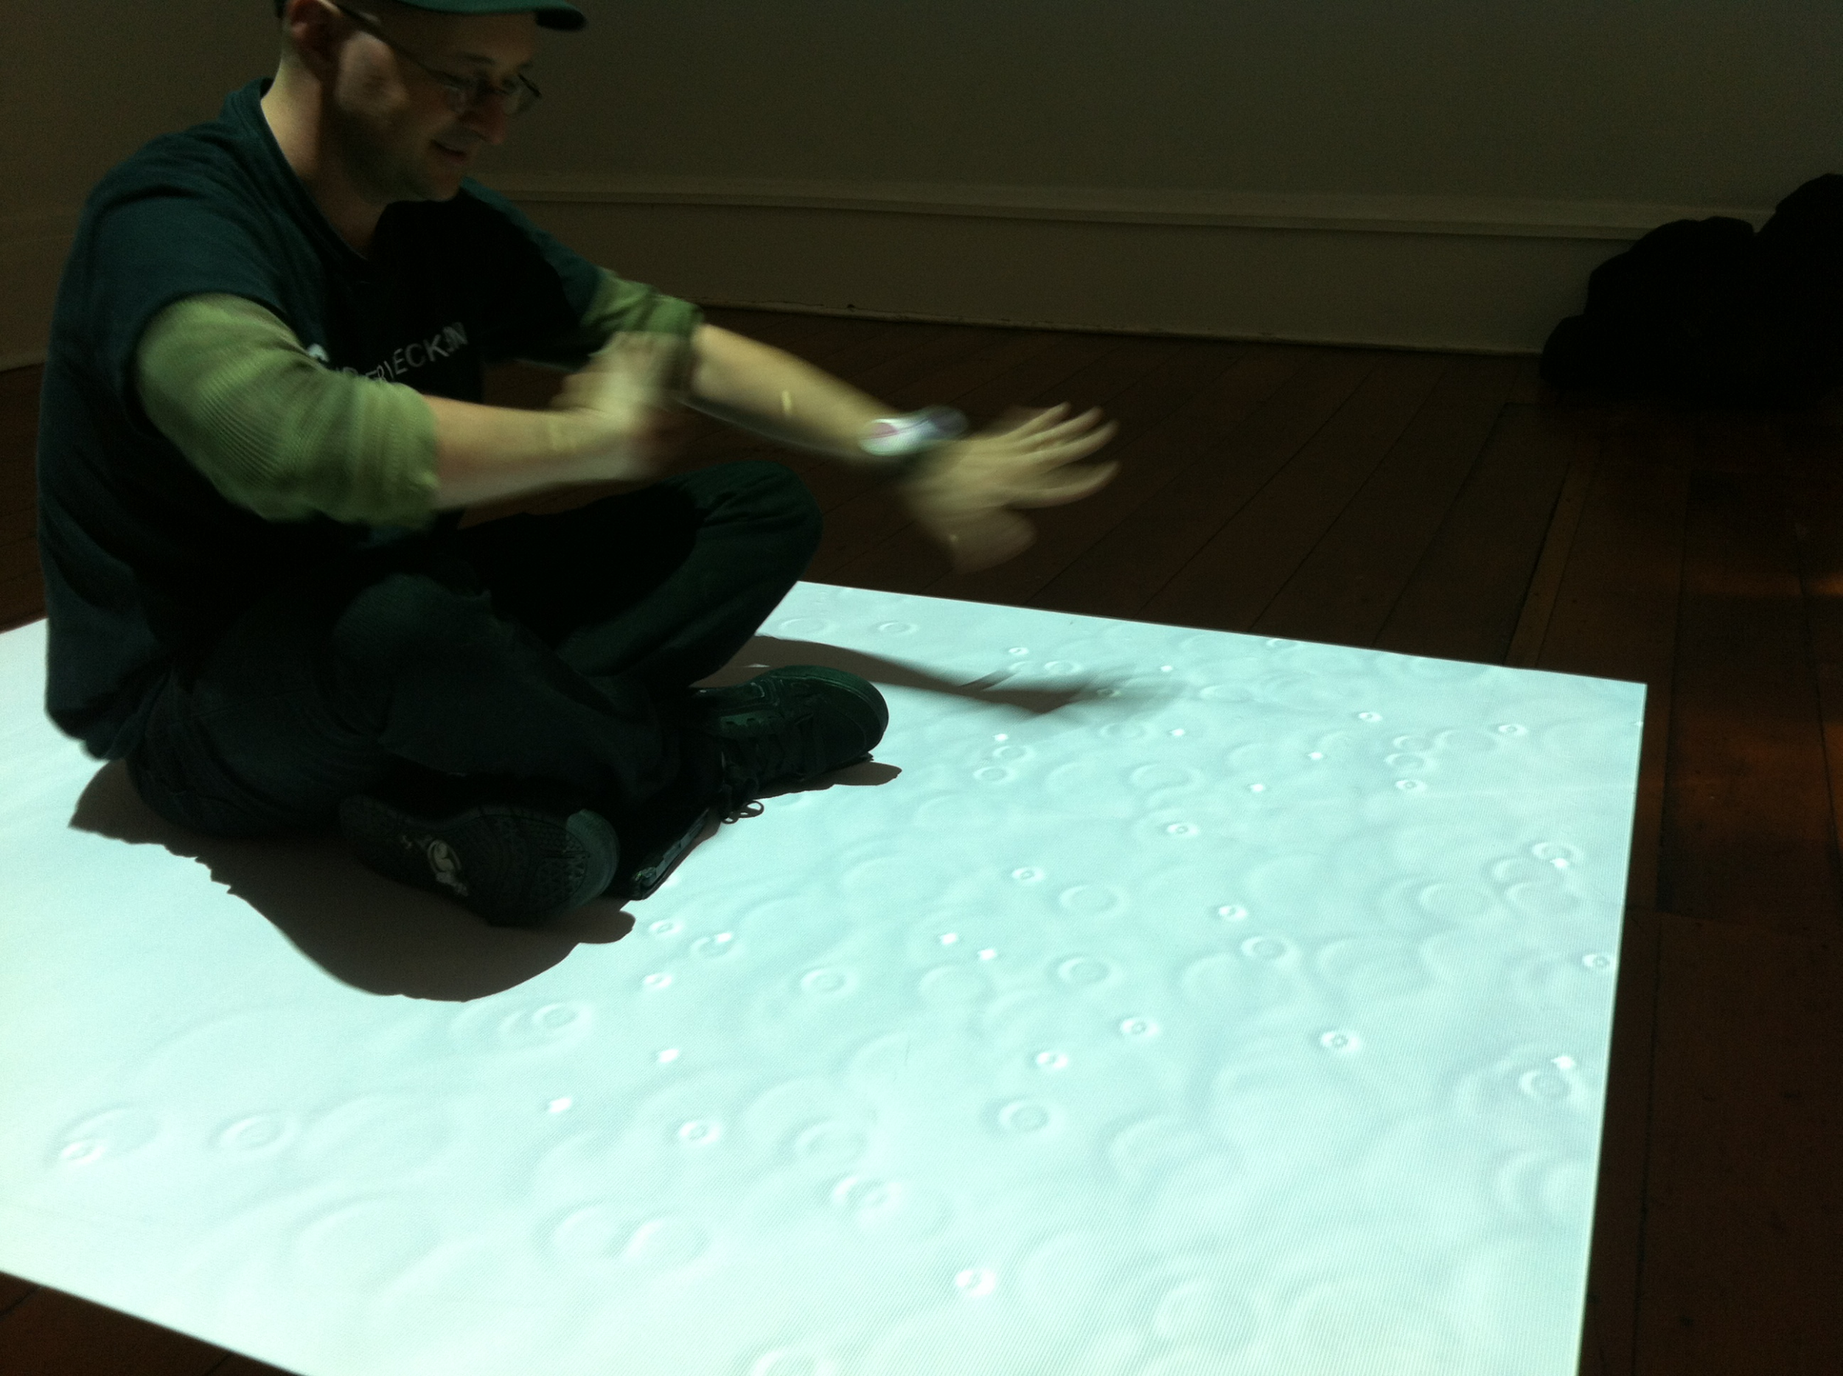
Notes:
Then we were given the opportunity
for some real world prototyping at The 30Upstairs gallery, in Wellington.
We were still in the BETA phase by this point,
so the location rendering for each rain droplet was a little off as we can see in this picture.

Slide 177
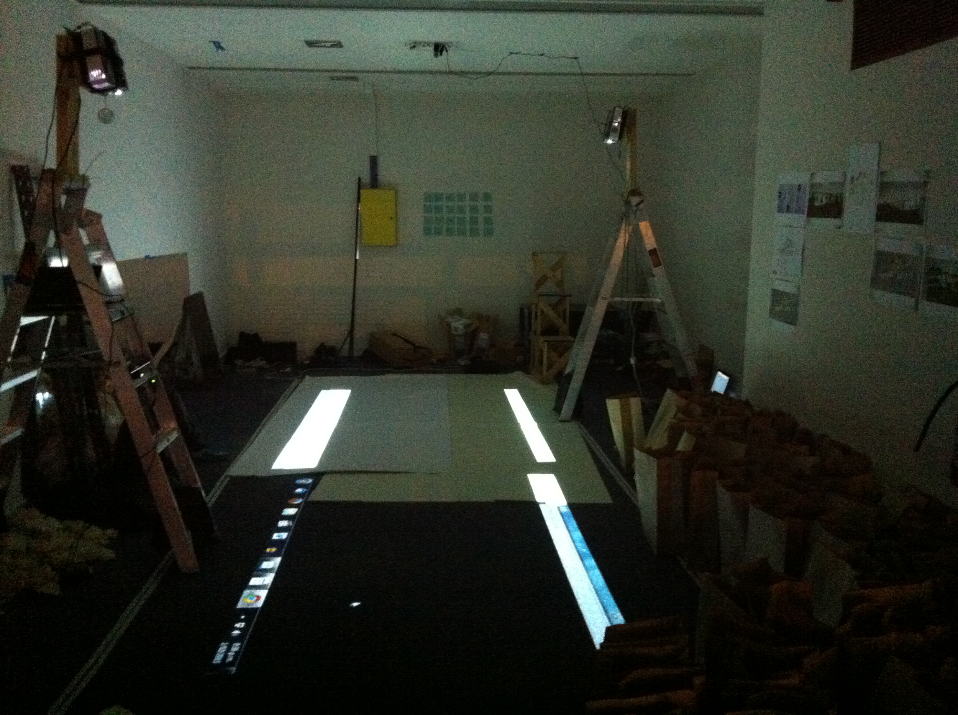
Notes:
Later on, we were provided with a space large enough to prototype a full sized instance.
We mapped out the dimensions of a shipping container on the floor,
and set up two instances of the application running.
This time, we made wooden mounts for the projectors, with screws… AND cable ties.

Slide 178
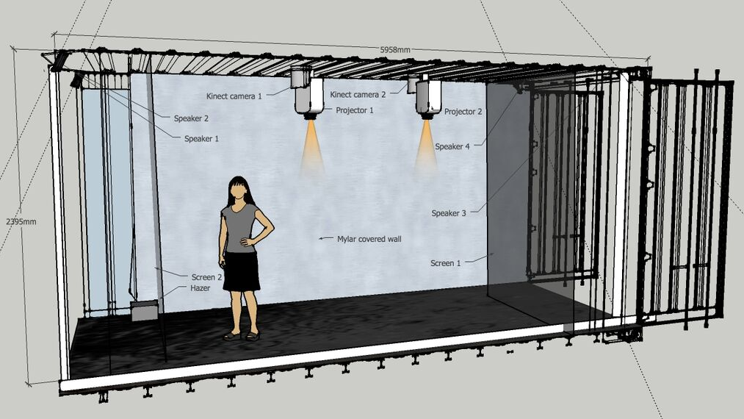
Notes:
Our initial plan was to mount the projectors and kinects in the middle at the top of the shipping contain.
This would have been tricky to mount and since we decided to create false interior walls,
we figured these would be more secure if fixed to the top and side of the contain.
A couple of short throw projectors allowed us to achieve this and still maintain a large clear projected image.

Slide 179
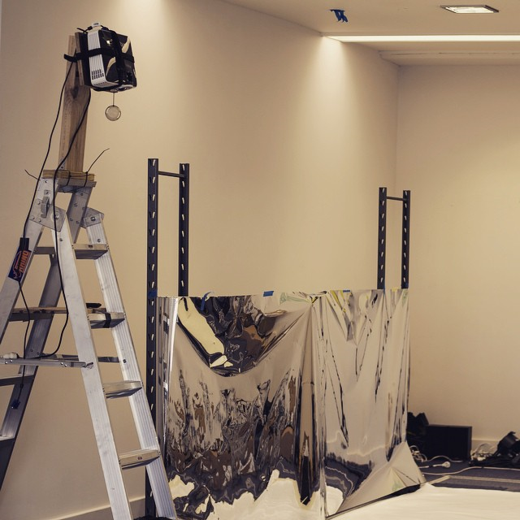
Notes:
We tested different materials next to the setup.
This picture is showing the projectors setup next to a sheet of mylar, a semi transparent reflective plastic.
We needed to see what would work best, given the amount of infrared and light that would be projected into the space..

Slide 180
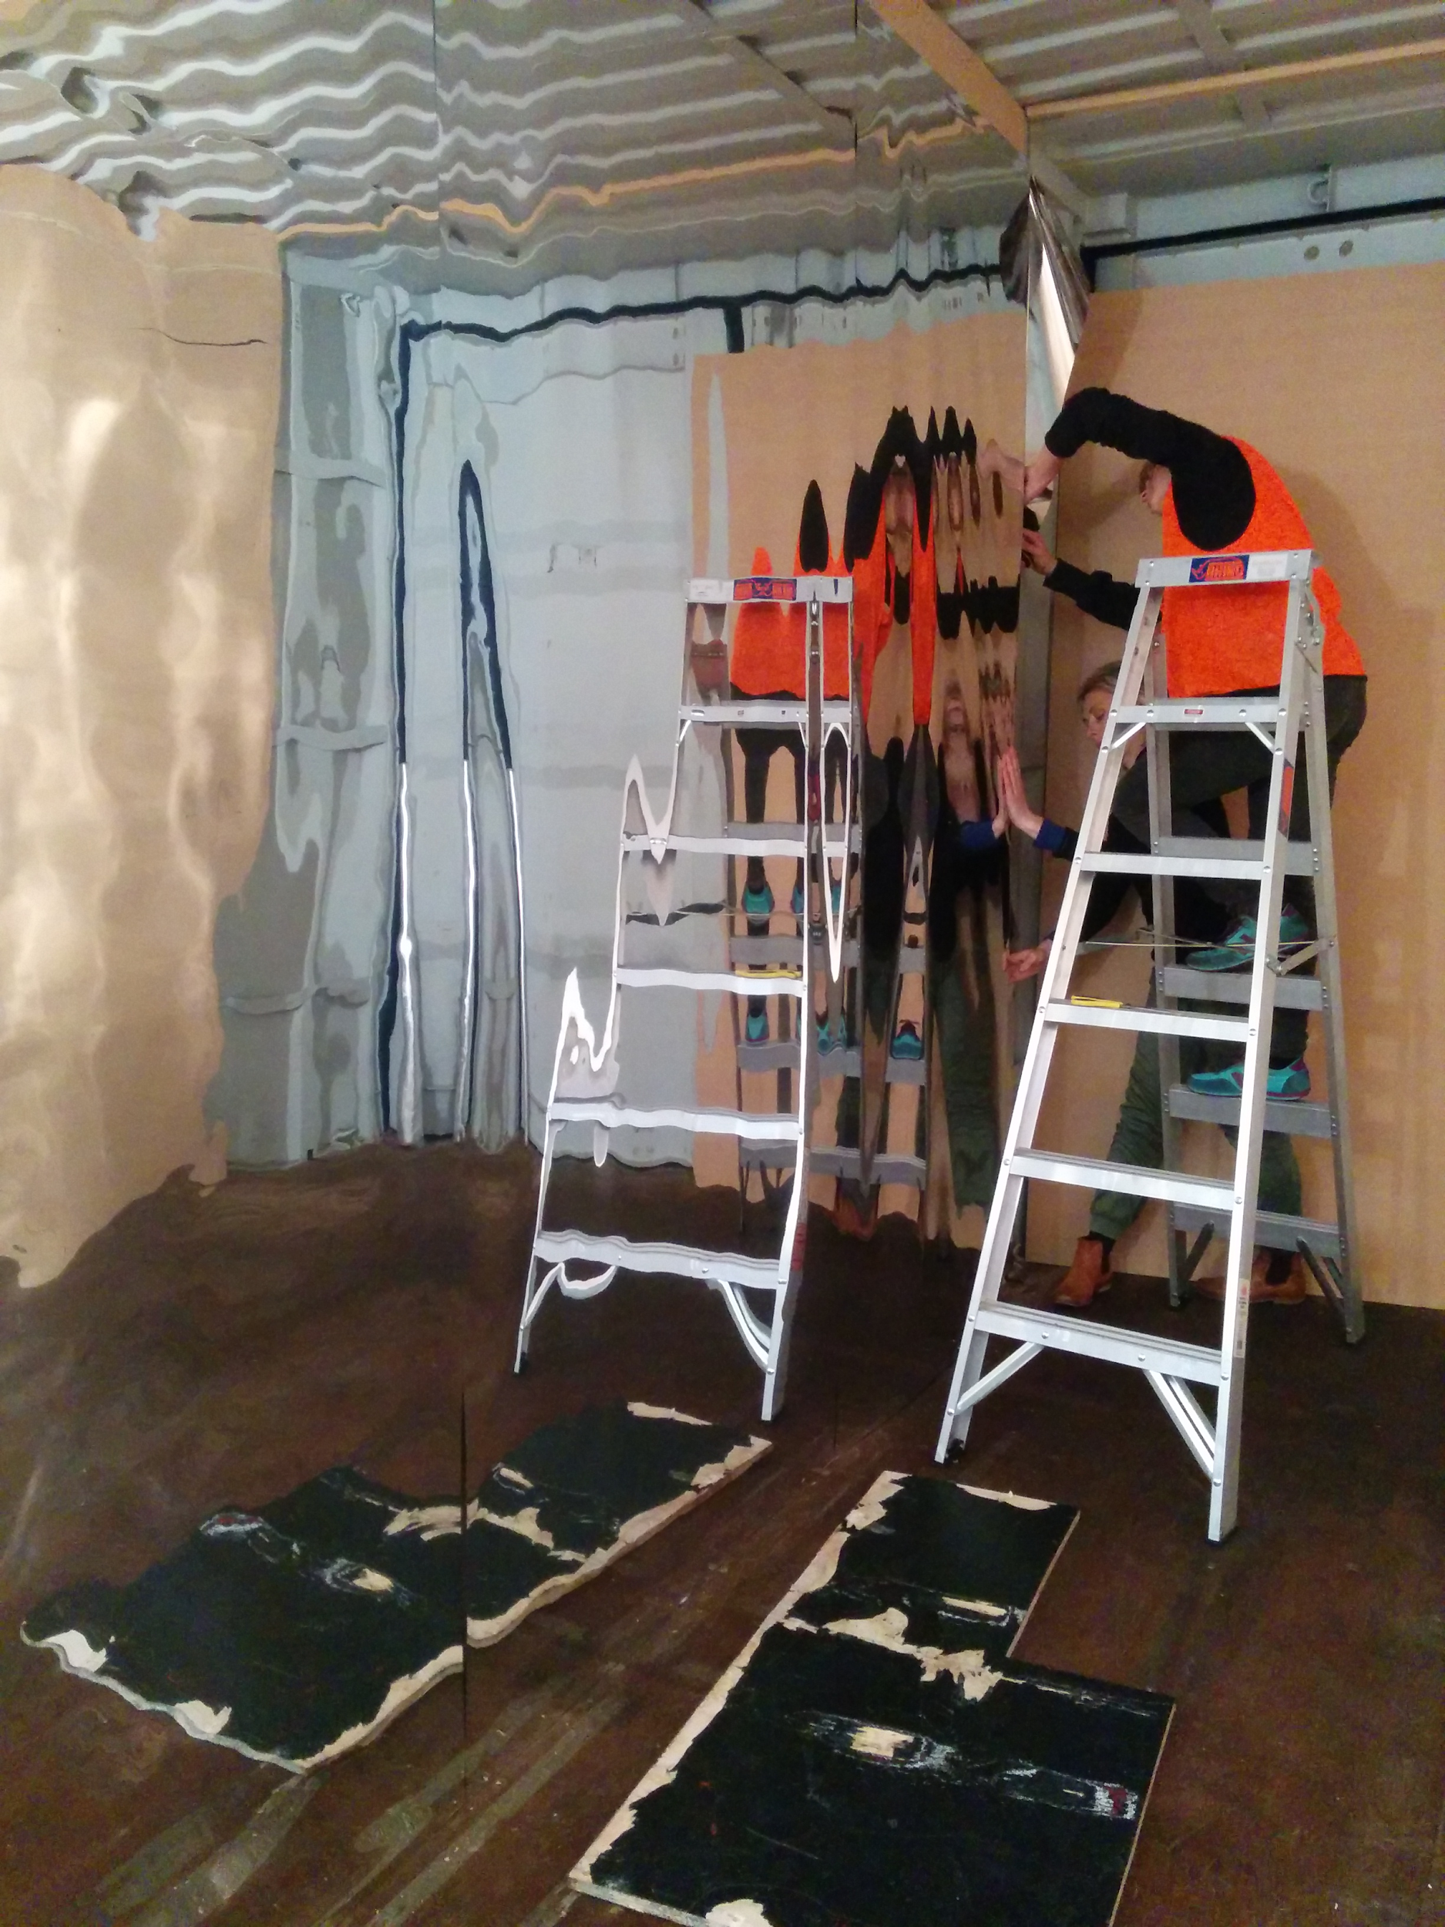
Notes:
Here’s a shot from inside the shipping container during setup.
The mylar gave a blurred mirror effect,
making the space feel wider than it actually was.
The reflections were soft and felt distant.
They distorted the space even more.

Slide 181

Notes:
Alright, we’ve been through the code,
all the components,
the space construction.
I better show you what this thing actually was.

Slide 182
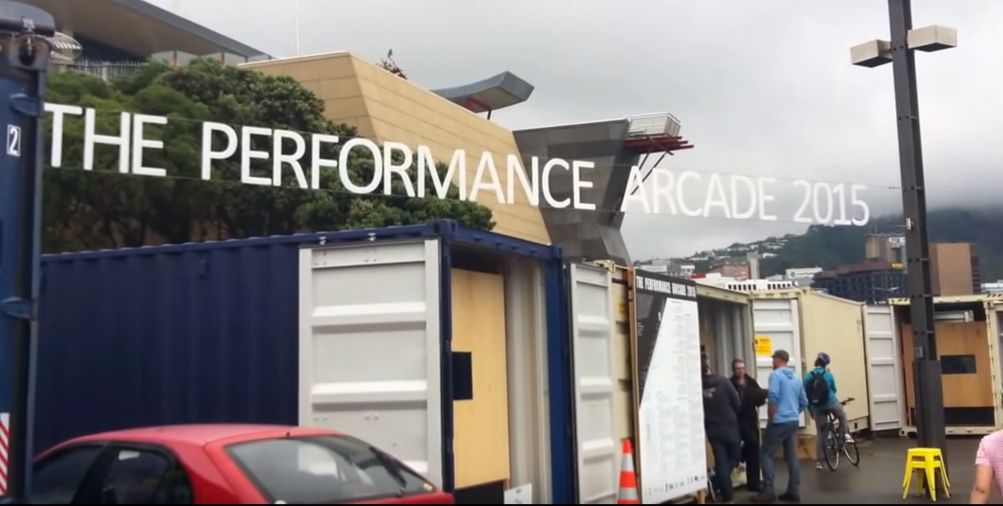
Notes:
Rainscape was featured in the 2015 Performance arcade, along the Wellington waterfront.
The arcade hosted a series of shipping container based art works.
Some were more interactive than others, but the continuing theme with all of them
was that they required some level of performance from someone.
That someone could be the artist or someone from the audience.
Hence the name - The Performance Arcade

Slide 183
Notes:
Here’s an overview of the final layout of our shipping container and all the components.
Obviously, not to scale, but you get the idea.

Slide 184
POWER
Notes:
Firstly, we needed to wire up all the components within the container
so that we could power them from an external power source.

Slide 185
Notes:
We made a hidden cupboard to help protect and hide all of our components.

Slide 186
LAPTOP 1
LAPTOP 2
Notes:
Each laptop, hidden inside the cupboard
ran an instance of the rainscape application
Each instance controlled one projector,
a kinect
and the set of speakers for that area of the container.

Slide 187
DMX
LAPTOP 1
Notes:
One of the laptops would also control the DMX light to flash on and off very quickly at the right interval.

Slide 188
KINECT-1
KINECT-2
Notes:
So now each kinect could read into the space below it...

Slide 189
KINECT-1
KINECT-2
Notes:
and using infrared, measure the distance at each pixel within the current frame.

Slide 190
KINECT-1
KINECT-2
Notes:
This information is sent back to the relative laptop,
which then calculates if motion has occurred at any of the points within the space.

Slide 191
KINECT-1
KINECT-2
Notes:
If it does calculate that motion has occurred within the space,
then we will broadcast a message using SignalR,
with the section to render the droplet in.

Slide 192
KINECT-1
KINECT-2
Notes:
This will then project onto the shipping container floor
at the section specified by signalR.
Triggering a droplet at that point
and animating it as a water ripple slowly fading away.

Slide 193
KINECT-1
KINECT-2
Notes:
The final aesthetics included the haze machine
which was set on a timer
to pump a hazy cloud into the shipping container,

Slide 194
KINECT-1
KINECT-2
CURTAINS
Notes:
We also hung up thick black curtains, at each end of the container,
to help minimize the amount of natural light that could enter the space
from either entrance.

Slide 195
KINECT-1
KINECT-2
Notes:
And finally, the internal walls were lined with mylar
to give the user a warped, distant feeling from the reflections.

Slide 196

Notes:
Unfortunately, I couldn’t bring the shipping container with me,
so you’ll just have to settle for some pictures and videos.
Capturing pictures of the projected rain droplets was very hard.
{play}
Because the space was already full of haze from the haze machine
and due to the fact that the rain droplets only rendered when motion occured,
it was hard to move about the space and record the small droplets of light.

Slide 197
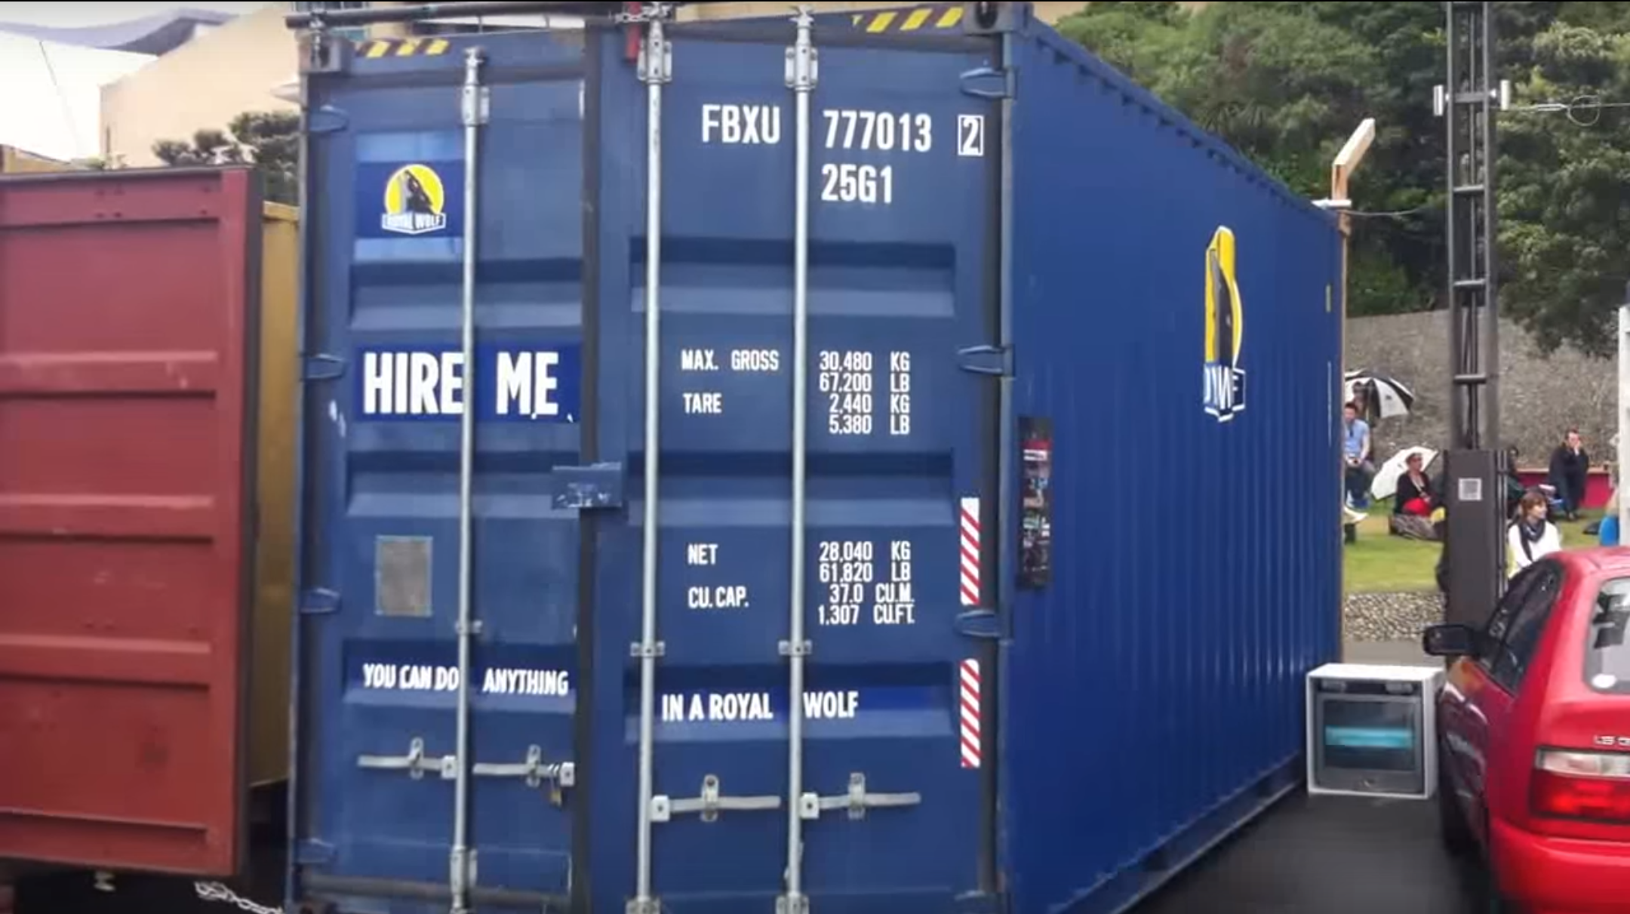
Notes:
Our shipping container was slightly taller than the others.
This was great because it meant that less people could reach up and mess with our projectors or kinects!

Slide 198

Notes:
Here’s a quick video of some users experiencing rainscape

Slide 199
If I could do it all
again...
Notes:
Obviously, this solution wasn’t perfect.
There were many flaws and little hacks to get it done.
Probably far too many cables ties made it into the final solution.
But if I were to redo this project all over again

Slide 200
Option 2.
Notes:
I would change the motion detection algorithm
to check the adjacent pixels and determine if enough change
had occurred across that area
to determine if motion had occurred.

Slide 201
Notes:
I would not use the kinect for xbox 360 again.
This technology came out in 2009 which means it’s practically ancient technology now.

Slide 202
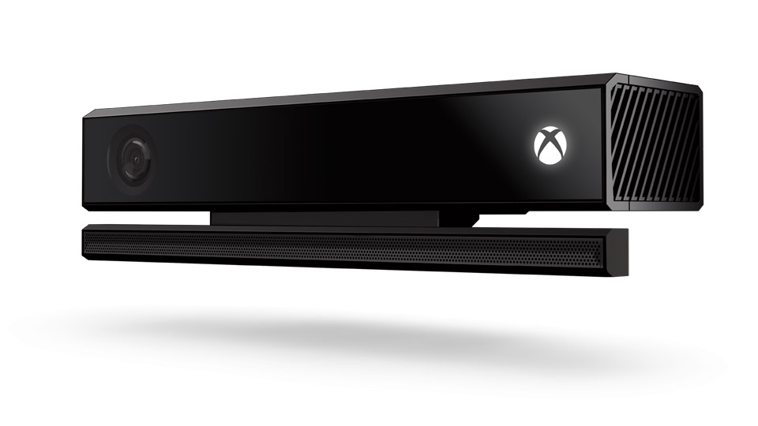
Notes:
I would like to recreate the entire solution with the latest version of the kinect.
It might have better SDK support.. (hopefully)

Slide 203
KINECT-1
KINECT-2
Notes:
I would also like to change the display.
In the shipping container,
we had separate instances of the application running for each half of the container.
An instance required one laptop to control only one kinect and one projector.
I would like to try network the machines
and use websockets to render onto a continuous canvas,
because it did not look very continuous with ripples rendering to invisible bounds in the middle.
This would mean that the ripples could overlap into the next view as opposed to just stopping at the edge of the display.

Slide 204
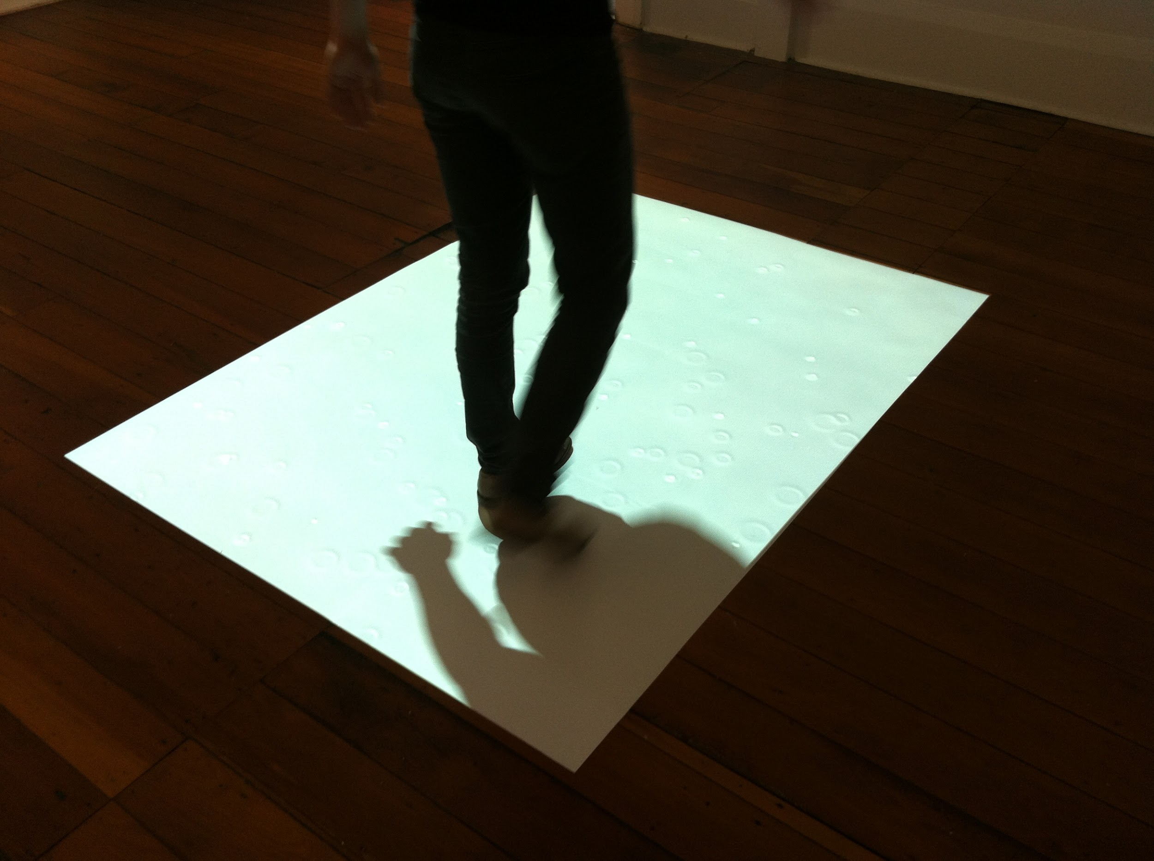
Notes:
During our prototype run, Debbie said to me that she’d always wanted to get into writing code,
but wasn’t sure how to get started.
Teaming up with people who do not write code for a living,
gives them the opportunity to see how the process is developed
and shares the knowledge with someone who
may not have otherwise known what to do or where to get started

Slide 205
code is
more than SOFTWARE
Notes:
Because writing code is so much more than just making software

Slide 206
break boundaries
CREATE MORE
Notes:
we need to break our conventional boundaries and create more than just code.

Slide 207
make art
Notes:
make art to help inspire others

Slide 208
make things
Notes:
make things to challenge yourself

Slide 209
be creative !
Notes:
But most of all, be creative.
If you have an idea, just do it.
Volatire said: “No problem can withstand the assault of sustained thinking”

Slide 210
I’m Lisa
@Lisa3x3x3
Notes:
I’m Lisa Taylor. I write C# code for a startup in New Zealand.
But I’m more than a developer. I’m an artist.
I use C# to create art.

Slide 211
Thank you
Notes:
Thank you

Slide 212
Resources:
Image: “Hi, I’m Lisa” photo credit: Lloyd Derby
Image: Wellington sign - http://www.go4travelblog.com/wp-content/uploads/2014/07/Wellington-Sign.png Image: Wellington Beehive - https://www.expedia.co.nz/Beehive-Wellington.d6108406.Attraction Image: Kiwi - http://www.kiwibird.org/wordpress/wp-content/uploads/baby-kiwi.jpg Image: Hobbits - http://www.theonering.com/galleries/the-lord-of-the-rings-movies/cast/the-hobbits-lila-sandybanks Image: Super heros - https://www.vectorstock.com/royalty-free-vector/superhero-couple-vector-745873 Image: Dark rain - http://www.fanpop.com/clubs/piyal-%25E2%259D%25A5/images/34558502/title/raining-photo Image: Clouds - http://www.wired.com/wp-content/uploads/blogs/insights/wp-content/uploads/2012/11/clouds_660.jpg Image: Lightning - http://ecmweb.com/site-files/ecmweb.com/files/archive/ecmweb.com/mag/706ecmLightningPic1.jpg Image: Kinect and kinect cross section and distance bar - MSDN.microsoft.com https://msdn.microsoft.com/en-us/library/jj131033.aspx Image: Motion - http://digital-photography-school.com/a-beginners-to-capturing-motion-in-your-photography/ Image: XKCD comic - https://xkcd.com/386/ Image: troll face - http://giphy.com/gifs/troll-you-mad-face-eVy46EWyclTIA Image: HTML5 Water Ripples - http://29a.ch/2010/10/23/html5-water-ripples-demo Image: DMX light - http://www.chauvetlighting.com/slimpar-tri-7-irc.html Image: Run DMC - img: http://www.legacyrecordings.com/a/#/artist/run-dmc/1158/ DMX library: https://github.com/agrath/Sniper.Lighting.Dmx HTML5 water ripples demo: http://29a.ch/2010/10/23/html5-water-ripples-demo Video: Rainscape: Rain, rain, come again - https://www.youtube.com/watch?v=g_hnkVDoaUw Video: Rainscape: Child’s play - https://www.youtube.com/watch?v=9MxIwz6wpcM

